Slide 1
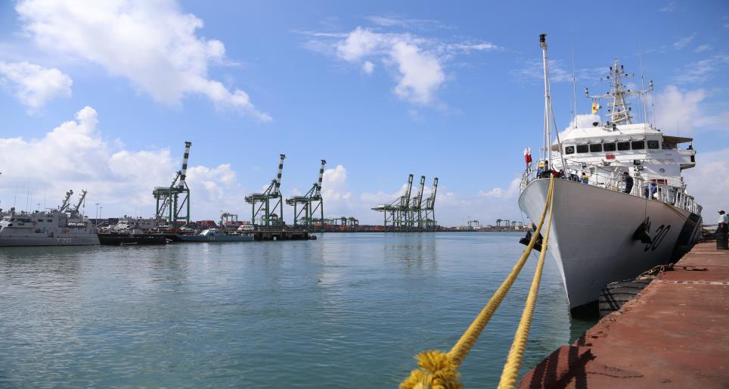
MARITIME INDIA SUMMIT 2016
NATIONAL MARITIME DAY 2025
Institution of Engineers (India),
UP State Centre, Lucknow
05th April 2025 C/E GAURAV ROHATGI

Slide 2
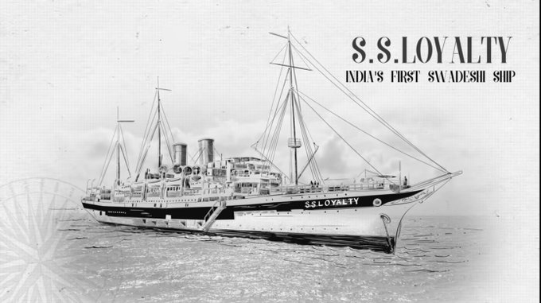
History of National Maritime Day
Indian National Maritime Day is observed on 5th April every year to commemorate the maiden voyage of MV Loyalty, India's first merchant ship, on that day in 1919. The day is celebrated to highlight the importance of the maritime sector to the country's economy and to recognize the contributions of the Indian seafarers.
12

Slide 3
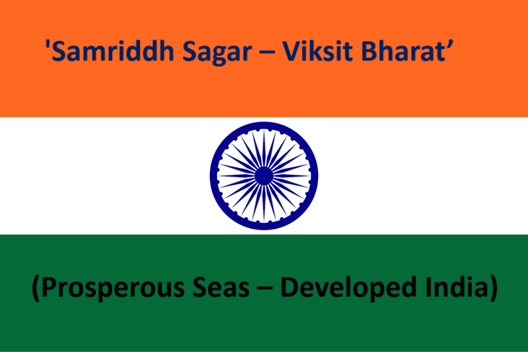
Theme of National Maritime Day
12

Slide 4
INDIAN GOVERNMENT’S INITIATIVES
The Maritime Sector is a Pillar of Economic Growth. India, with its long coastline, and has a thriving shipping industry that facilitates 95% of our trade by volume.
Sagarmala
Maritime Vision 2030
These are transformative initiatives designed to position India as a maritime powerhouse.
12

Slide 5
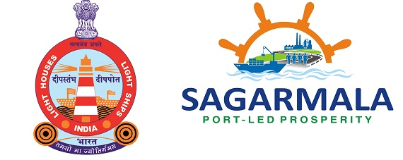
Launched in March 2015, is aimed at revolutionizing India’s maritime sector.
With a 7,500 km coastline, 14,500 km of potentially navigable waterways, and a strategic position on key global trade routes, it aims to streamline logistics, reduce costs, and enhance international trade competitiveness by shifting from traditional, infrastructure-heavy transport to efficient coastal and waterway networks.
The program focuses on port modernization, industrial growth, job creation, and sustainable coastal development, ensuring minimal infrastructure investment while maximizing economic impact.
The Sagarmala Programme is a key pillar of the Maritime Amrit Kaal Vision 2047 (MAKV).
MAKV sets ambitious targets to position India among the top five shipbuilding nations by 2047.
Notes:
The Sagarmala Project is a flagship initiative of the Government of India aimed at port-led development to boost the country’s economy. Launched in 2015, the project focuses on modernizing ports, improving logistics, and enhancing coastal and inland waterways to reduce transportation costs and increase trade efficiency.

Slide 6
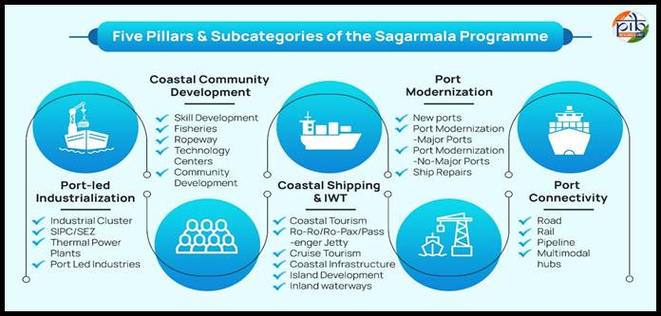
Components of the Sagarmala Programme

Slide 9
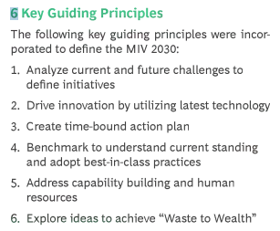

Slide 11
Key Themes of SAGARMALA & MIV 2030
Key themes essential for India to secure its place at the forefront of the Global Maritime Sector:
Develop best-in-class Port infra structure With Logistics Efficiency and Cost Competitiveness
Enhance Logistics Efficiency through Technology and Innovation
Enhance Global Share in Ship Building, Repair and Recycling
Enhance Cargo and Passenger Movement through Inland Waterways
Promote Ocean, Coastal and River Cruise Sector
Enhance India’s Global stature and & Lead the World in Safe, Sustainable & Green Maritime Sector
Become Top Seafaring Nation with World Class Education, Research & Training
Key interventions have been identified for promoting Research & innovation, enhancement of Education & Training, development of conducive ecosystem to enhance the know how and standards of marine fraternity.

Slide 12
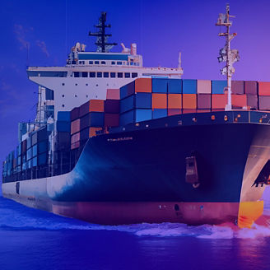
Blue Economy Harnessing Ocean Resources for Sustainable Development
Blue Economy: A Pathway to Sustainable Growth
The Blue Economy refers to the sustainable use of ocean resources for economic growth, improved livelihoods, and environmental health. It emphasizes balancing economic activities with marine ecosystem conservation, ensuring that our oceans remain productive for future generations.

Slide 13
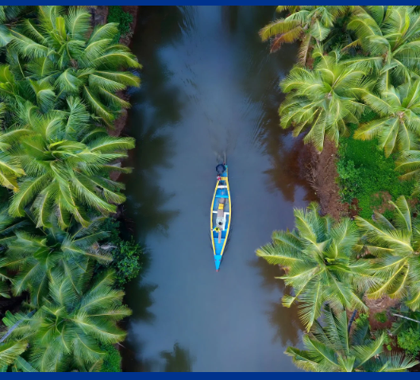

Slide 14
1. Fisheries and aquaculture
India ranks as the world's third-largest fish producer, poised to achieve a CAGR of 24.6 per cent in fisheries between 2016 and 2030, outperforming other major producers such as China, Indonesia and Vietnam. The sector employs millions directly and indirectly, with aquaculture playing a pivotal role in meeting domestic seafood demand. Initiatives such as the Pradhan Mantri Matsya Sampada Yojana (PMMSY) aim to bolster the sector's resilience and sustainability, highlighting the need for further technological advancement.

Slide 15
2. Maritime transport
Maritime transport is pivotal for India's trade and efforts are underway to make the sector more sustainable. The Maritime Amrit Kaal Vision 2047 includes strategies to decarbonise shipping, introduce green fuels such as hydrogen and ammonia and create carbon-neutral ports. These initiatives aim to align India's maritime industry with global climate goals, including reducing greenhouse gas emissions from international shipping by 2050.

Slide 16
3. Marine tourism
Tourism in coastal and island regions is a key component of the blue economy, providing a source of income for local communities. However, challenges such as over-tourism and the need for sustainable infrastructure remain. Eco-friendly tourism practices and community engagement are essential to balancing economic benefits with environmental preservation.

Slide 17
4. Technological innovation
Technology plays a transformative role in overcoming challenges in India's blue economy. Innovations such as satellite monitoring, artificial intelligence and blockchain improve marine resource management, predict weather patterns, and enhance transparency in supply chains. Additionally, renewable marine energy technologies such as tidal turbines and wave energy converters demonstrate the potential for harnessing ocean currents and waves to support sustainable energy production.

Slide 18
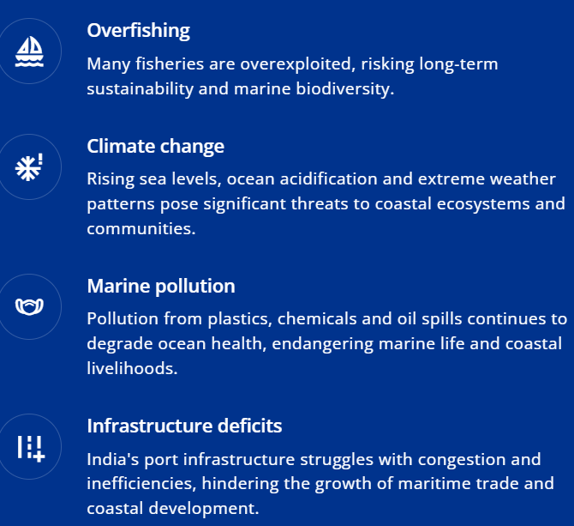
Sustainable fisheries management
Improved regulatory frameworks and advanced technologies promote responsible fishing practices, helping to replenish fish stocks and ensure long-term sustainability.
Climate resilience
Investments in renewable marine energy and coastal infrastructure mitigate climate change impacts while supporting economic growth.
Enhanced pollution control
Strengthened environmental regulations combined with innovations in waste management and pollution control preserve marine ecosystems.
Modernised ports
Upgrading port infrastructure with green technologies and streamlining logistics improves efficiency and reduces environmental impact.

Slide 19
By 2035, India's coastal shipping modal share is expected to grow from 6 per cent to 33 per cent, reflecting the robust potential for economic expansion.
India’s blue economy represents a critical opportunity to address pressing economic and environmental challenges.
The future of the blue economy in India hinges on innovative practices, effective policies, and responsible development, ensuring a prosperous and sustainable ocean economy.

Slide 20
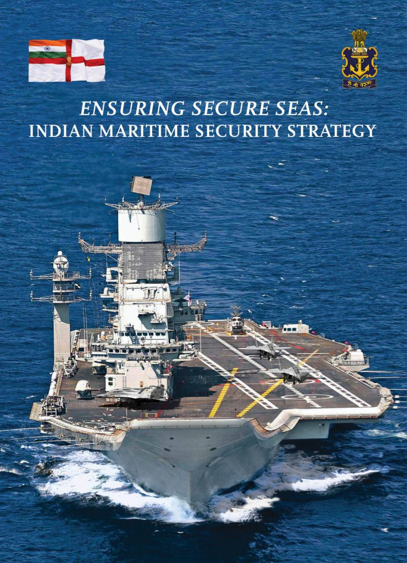
Maritime Security and Safeguarding Our Seas: The Indian Perspective
The Indian Ocean Region (IOR) is vital for global trade, energy security, and geopolitical stability. However, it faces multiple challenges, including piracy, terrorism, illegal fishing, smuggling, and rising geopolitical tensions.
Ensuring maritime security is essential not only for national defense and economic growth but also for regional stability and global maritime order. India's approach includes strengthening naval power, coastal security, international partnerships, and advanced surveillance systems to safeguard its maritime interests.

Slide 21
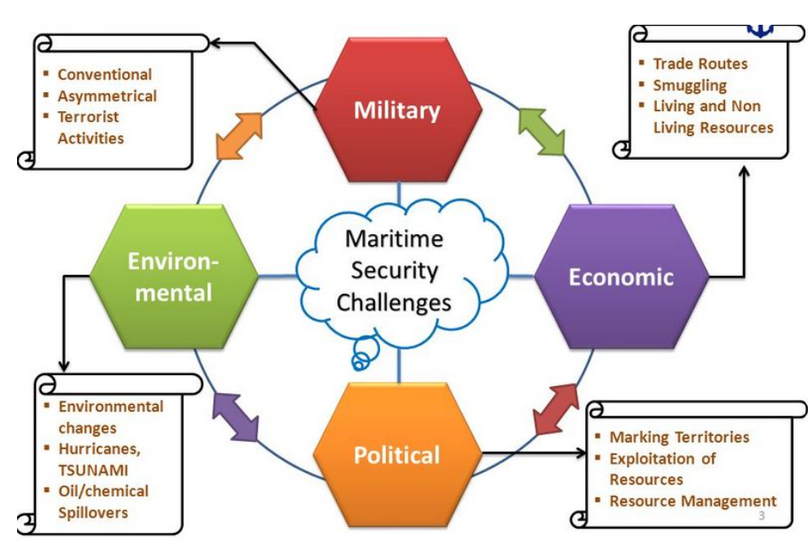
Maritime Threats

Slide 22
Indo-Pacific Oceans Initiative (IPOI) & 'Security and Growth for All in the Region (SAGAR)'
IPOI is a non-treaty-based voluntary arrangement that promotes cooperation for a free and open Indo-Pacific and the rules-based regional order launched by India in 2019 at the East Asia Summit (EAS) in Bangkok (Thailand). It seeks to build a sense of community by creating new partnerships with like-minded countries through practical cooperation.
SAGAR vision was launched in 2015 to have inclusive development joining economic assistance and maritime security concerns on a common platform while respecting international maritime laws and norms.
Our SAGAR (Security and Growth for All in the Region) initiative enhances maritime cooperation with neighboring nations, reinforcing India’s role as a responsible maritime power. Investments in modern surveillance technologies and strategic naval alliances ensure that our seas remain safe and beneficial for all.

Slide 23
Future Roadmap for Maritime Security
✅ Blue Water Navy Vision
Expanding India’s global naval reach with more aircraft carriers & nuclear submarines.Enhancing joint naval drills with ASEAN, Africa, and Middle Eastern allies.
✅ AI & Cybersecurity in Naval Warfare
Using AI-driven surveillance systems and autonomous underwater drones.Strengthening cybersecurity for naval bases & critical maritime infrastructure.
✅ Green Maritime Security
Carbon-neutral naval bases and LNG-powered patrol ships to reduce environmental impact.
✅ Expanding Marine Protected Areas (MPAs) to safeguard coral reefs and fisheries.
✅ Stronger Laws Against Maritime Crimes
Stricter penalties for illegal fishing, piracy, and marine pollution.

Slide 25
India’s Maritime Vision for 2047 –Becoming a Maritime Superpower
By 2047, India aims to:
✅ Be among the top 5 global shipping nations.
✅ Have 100% smart, green, and AI-driven ports.
✅ Dominate global maritime trade with efficient supply chains.
✅ Lead in ocean-based industries, sustainable fisheries, and blue economy growth.
✅ Be a net exporter of ships and marine technology.

Slide 26
Environmental Sustainability & Ocean Conservation in India
The maritime industry contributes significantly to carbon emissions through:
Shipping & Port Operations: The burning of fossil fuels (heavy fuel oil, diesel) in cargo ships emits CO₂, SO₂, and NOx, contributing to global warming and ocean acidification.
Coastal Industries & Urbanization: Oil refineries, power plants, and factories near the coast release pollutants into the air and water.
Plastic Waste & Marine Pollution: India generates over 3.4 million tonnes of plastic waste annually, much of which ends up in the ocean.
Deforestation of Mangroves: Loss of mangrove forests (natural carbon sinks) increases carbon emissions and reduces coastal resilience.

Slide 27
Green Shipping & Carbon Reduction Initiatives
✅ Maritime Vision 2030: Targets LNG-powered and hydrogen-fueled ships, reducing carbon emissions.
✅ Green Port Policy: Use of renewable energy (solar & wind) in ports.
Implementation of shore power supply (cold ironing) to reduce ship emissions while docked.Conversion of diesel port equipment to electric/hybrid models.
✅ National Action Plan on Climate Change (NAPCC)
Includes National Adaptation Fund for Climate Change (NAFCC) to support marine and coastal sustainability projects.

Slide 28
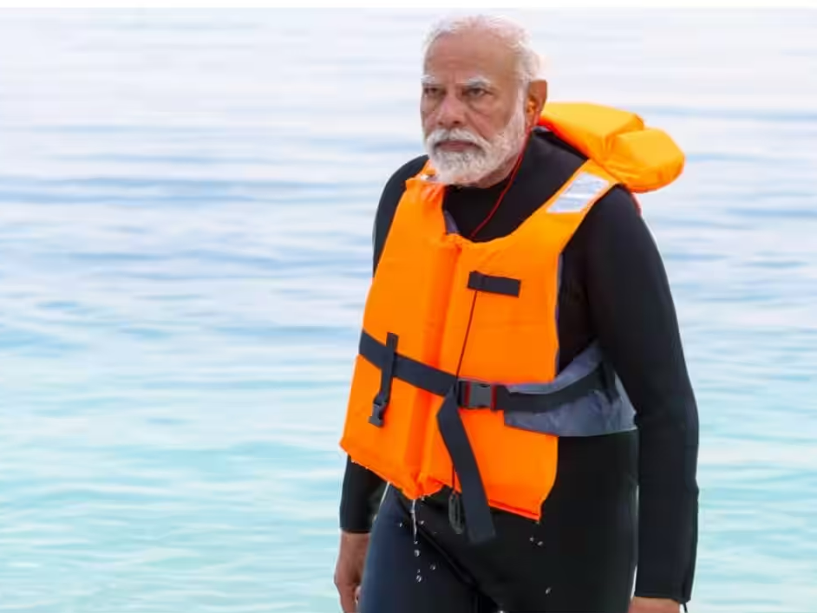
Hon’ble Prime Minister Shri Modi ji VISION
Under the visionary leadership of Hon’ble Prime Minister Shri Narendra Modi ji, we are not just adapting to change; we are driving it.
Through initiatives like the
‘Harit Sagar Green Port Guidelines’
‘Green Tug Transition Programme’
‘National Green Hydrogen Mission’,
we are transforming our ports and shipping industry into beacons of sustainability

Slide 29
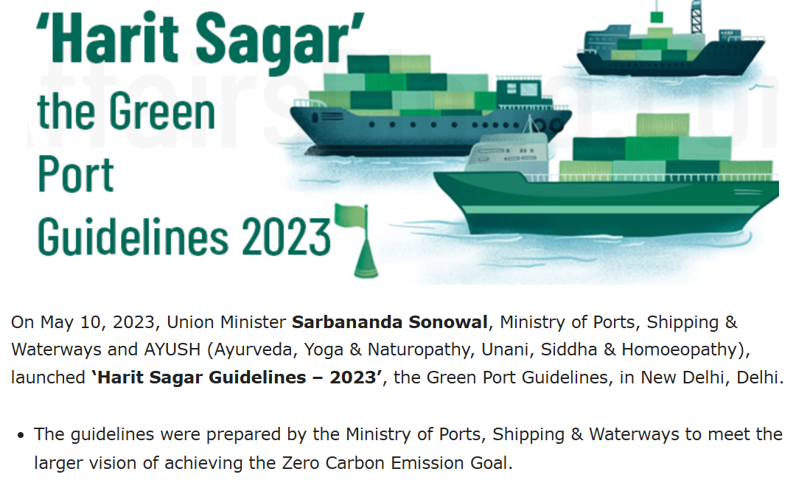

Slide 30
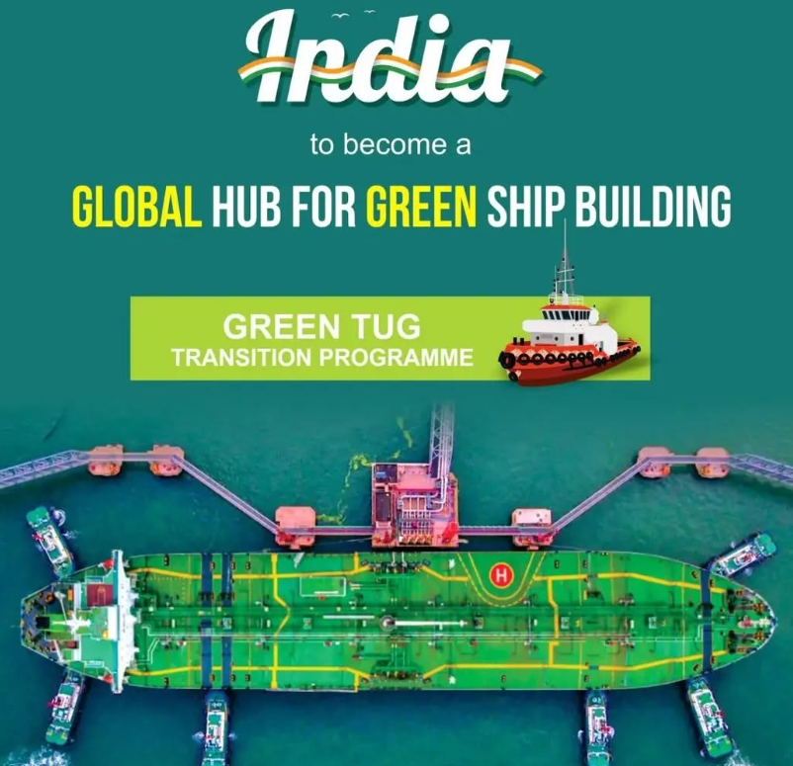
The Green Tug Transition Program (GTTP)
The Green Tug Transition Program (GTTP) aims to replace India's conventional, diesel-powered harbor tugs with greener alternatives.
The GTTP seeks to transition India's harbor tug fleet to cleaner, more sustainable options, ultimately aiming to become a "Global Hub for Green Ship" building by 2030.

Slide 31
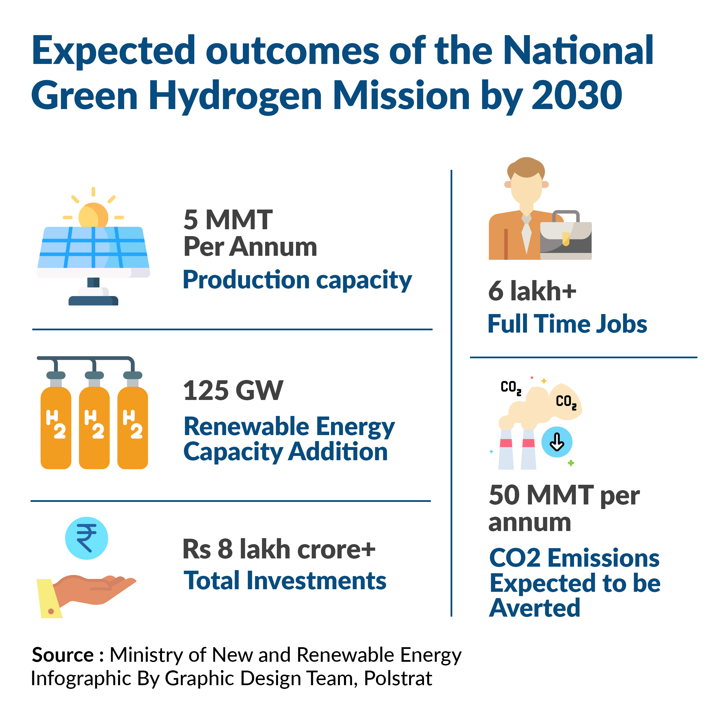
The National Green Hydrogen Mission (NGHM)
The National Green Hydrogen Mission (NGHM) is a program to make India a global leader in green hydrogen production, use, and export.
To reduce India's reliance on fossil fuels
To decarbonize the economy
To establish India as a leader in green hydrogen technology and markets
To promote sustainable energy practices

Slide 32
India’s Marine Renewable Energy & Sustainable Blue Economy
India is investing in renewable energy from the ocean to reduce dependency on fossil fuels:
A. Offshore Wind & Wave Energy
India has set a target of 30 GW of offshore wind power by 2030 in Gujarat & Tamil Nadu.
B. Ocean-Based Carbon Sequestration (Blue Carbon Initiatives)
Mangrove Restoration Projects in Sundarbans, Maharashtra, and Andaman & Nicobar Islands.
Seaweed Farming for biofuels, carbon sequestration, and reducing ocean acidification.
C. Sustainable Fisheries & Marine Tourism
Expansion of Marine Protected Areas (MPAs) to safeguard coral reefs and marine species.Eco-friendly tourism policies to preserve marine biodiversity while boosting the economy.

Slide 34
Blue economy for India means a number of economic opportunities related to ocean and marine ecosystems, playing an important role in generating and sustaining livelihoods

Slide 36
Marine Biodiversity Conservation & Ecosystem Protection
✅ Blue Flag Certification beaches: India has 12 Blue Flag-certified eco-friendly beaches, promoting sustainable coastal tourism.
✅ Deep Ocean Mission (DOM): Focuses on marine biodiversity studies, coral reef restoration, and sustainable deep-sea mining.
✅ National Biodiversity Action Plan (NBAP): Protects marine life and habitats through fishing bans, protected marine areas, and ecosystem restoration.

Slide 37
Waste Management & Marine Pollution Control
✅ India’s Single-Use Plastic Ban (2022):
Phased ban on plastic straws, cutlery, and polythene bags.
Promotion of biodegradable packaging & recycling initiatives.
✅ National Oil Spill Disaster Contingency Plan (NOS-DCP): Ensures rapid response to oil spills to protect marine life and coastal economies.
✅ Waste-to-Wealth Programs: Encourages circular economy models in ports and coastal industries to recycle waste.

Slide 39
Conclusion of today’s presentation
India’s maritime future depends on sustainability, innovation, and responsible ocean governance. By reducing carbon footprints, adopting clean energy, protecting marine biodiversity, and enforcing strict regulations, India is positioning itself as a leader in global ocean conservation and maritime sustainability.
Through initiatives like Sagarmala, Maritime Vision 2030, and Deep Ocean Mission, India is striving towards a clean, green, and prosperous ocean economy – truly realizing the vision of "Samriddh Sagar, Viksit Bharat" (Prosperous Seas, Developed India).

