Slide 1
Technological Approach for Achieving Sustainable Development Goals
R.C. Srivastava
FNAAS, FISAE, FIASWC,FIE, FCHAI, FJISL,FBVD,
Former Vice Chancellor, Dr Rajendra Prasad Central Agricultural University, Pusa, Samastipur (Bihar)
Former Director, ICAR- Central Island Agriculture Research Institute, Port Blair (A & N Islands)
Former Director, ICAR-Indian Institute of Water Management, Bhubaneswar

Slide 2
Wish you all a very happy
World Engineers Day

Slide 3
What is Role of Engineers
Engineers are the architect of progress , turning dreams in reality with their innovation and dedication

Slide 4
Another view about Engineers
Engineers like to solve problems. If there are no problems handly available , they will create their own problems

Slide 5
Theme of World Engineering Day
World Engineering Day for Sustainable Development is celebrating this day under the theme: "Shaping a Sustainable Future Through Engineering".
This theme emphasizes the critical role engineering plays in achieving the United Nations' Sustainable Development Goals (SDGs).
The 2025 celebration aims to bring together policymakers, leading scientists, engineers, industry representatives, and international organizations to explore how engineering can drive sustainable development and address global challenges.

Slide 6
What are UN SDGs
SDG : Sustainable Development Goals
Designed to address major global challenges, including poverty, inequality, climate change, environmental degradation, peace, and justice.
Adopted as part of the 2030 Agenda for Sustainable Development by all 193 UN member states.
These goals were finalized on September 25, 2015 at United Nations Headquarters, New York, USA and was adopted during UN Sustainable Development Summit

Slide 7
What are UN SDGs (Contd)
The SDGs were built upon the Millennium Development Goals (MDGs) (2000-2015) and were designed to be more inclusive, comprehensive, and universally applicable.
They address global challenges, including poverty, inequality, climate change, environmental degradation, peace, and justice.
The target year to achieve these goals is 2030.

Slide 8
What are UN SDGs (Contd)
In all there are 17 SDGs, and almost all have role of engineers in achieving that.
These goals are interconnected, meaning progress in one can impact others. The UN encourages governments, businesses, and individuals to work together to achieve these ambitious targets by 2030
These goals can be achieved with technologies available, social and institutional constraints in applying these technologies in field.

Slide 9
SDGs which this address will deal
(i) Zero Hunger – End hunger, achieve food security, and promote sustainable agriculture;
(ii)No Poverty – End poverty in all its forms everywhere;
(iii) Clean Water and Sanitation – Ensure availability and sustainable management of water and sanitation for all;
(iv) Climate Action – Take urgent action to combat climate change and its impacts;
(v) Life on Land – Protect, restore, and promote sustainable use of terrestrial ecosystems, forests, and biodiversity.

Slide 10
Zero Hunger
Government of India has already moved in this direction by providing 5 kg grains to about 800 million people so it can be assumed that this goal has been achieved upto good extent.
However, there is need of ensuring that the lowest strata of society not only get foodgrain to satisfy its hunger, but also ensure their nutrient security.
Hydroponic production of vegetables can be one technology which if adopted properly can fill this gap.
Since a large poor population has been covered under PM Aawas Yojna, this technology can easily be used

Slide 11
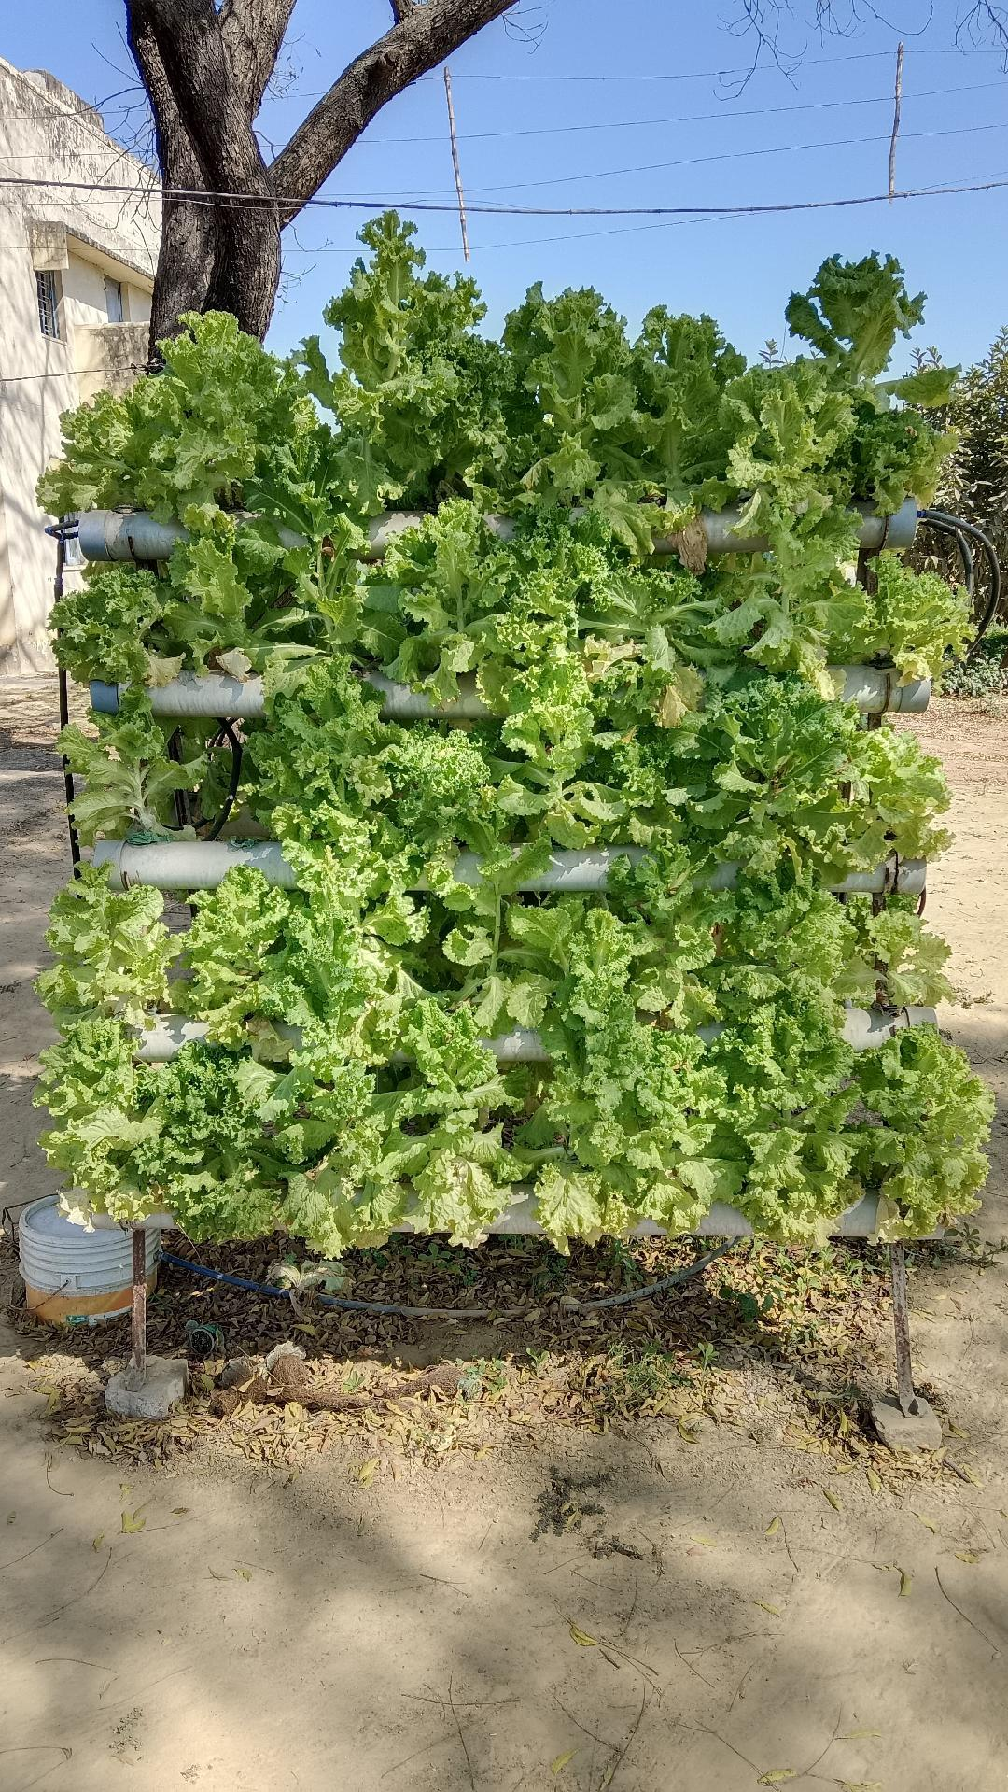
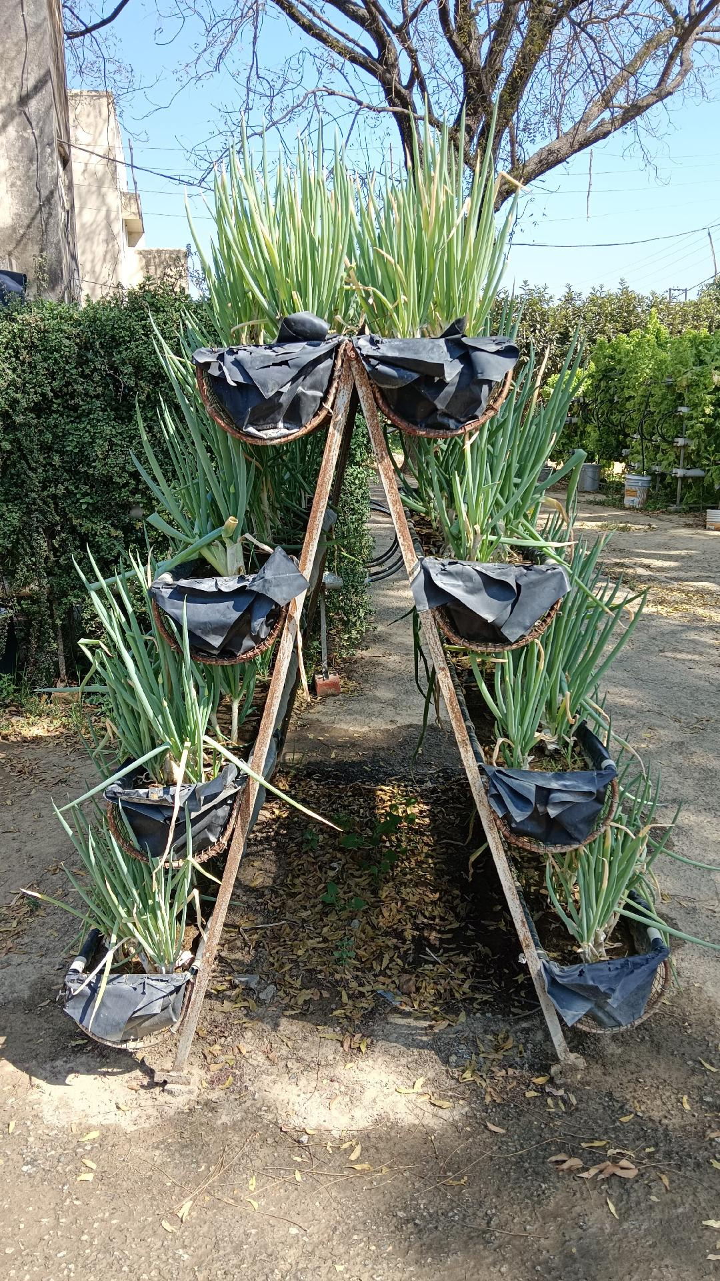
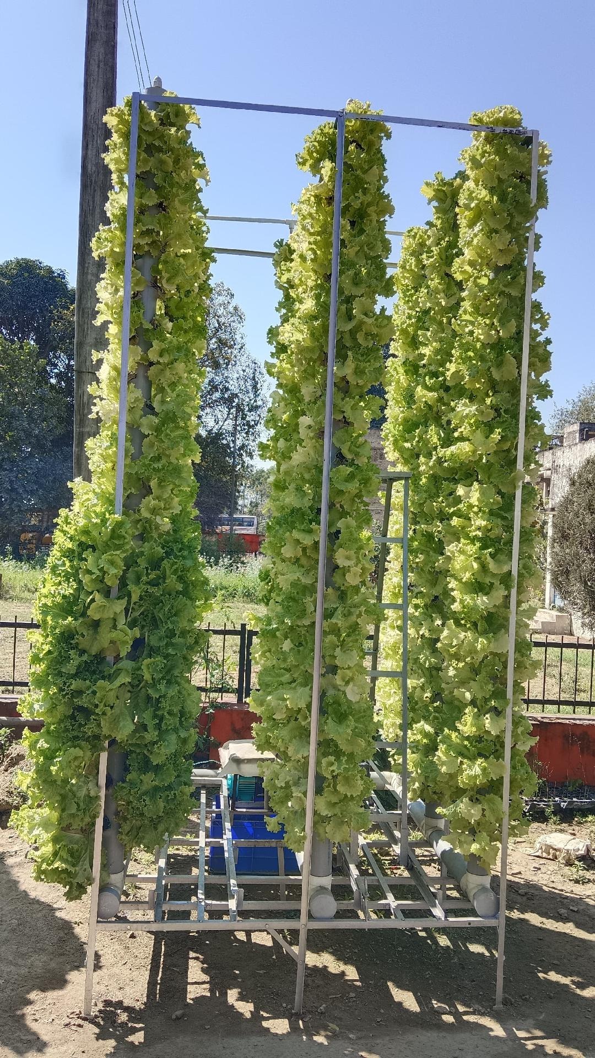
Hydroponic cultivation of vegetables near homestead/ roofs (Courtsey CISH, Lko)

Slide 12
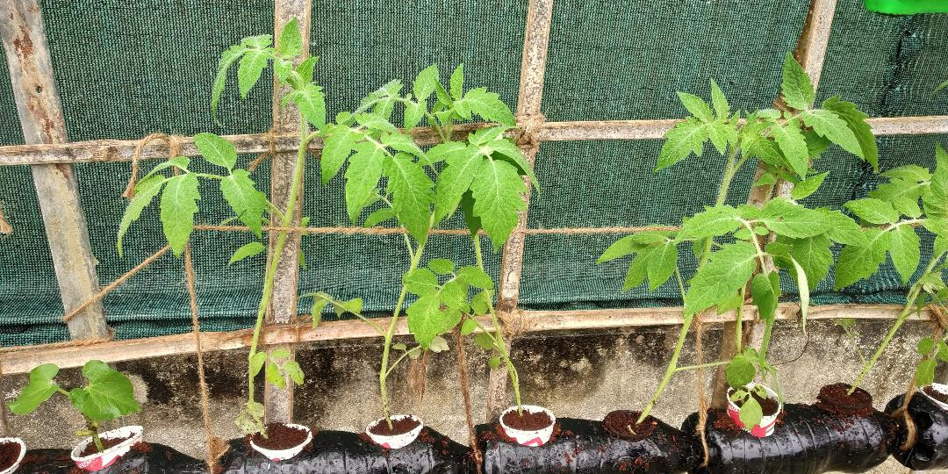
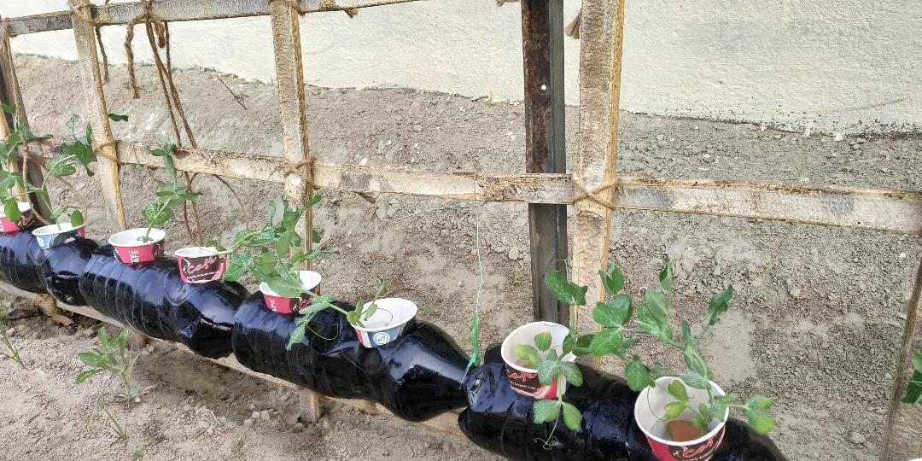
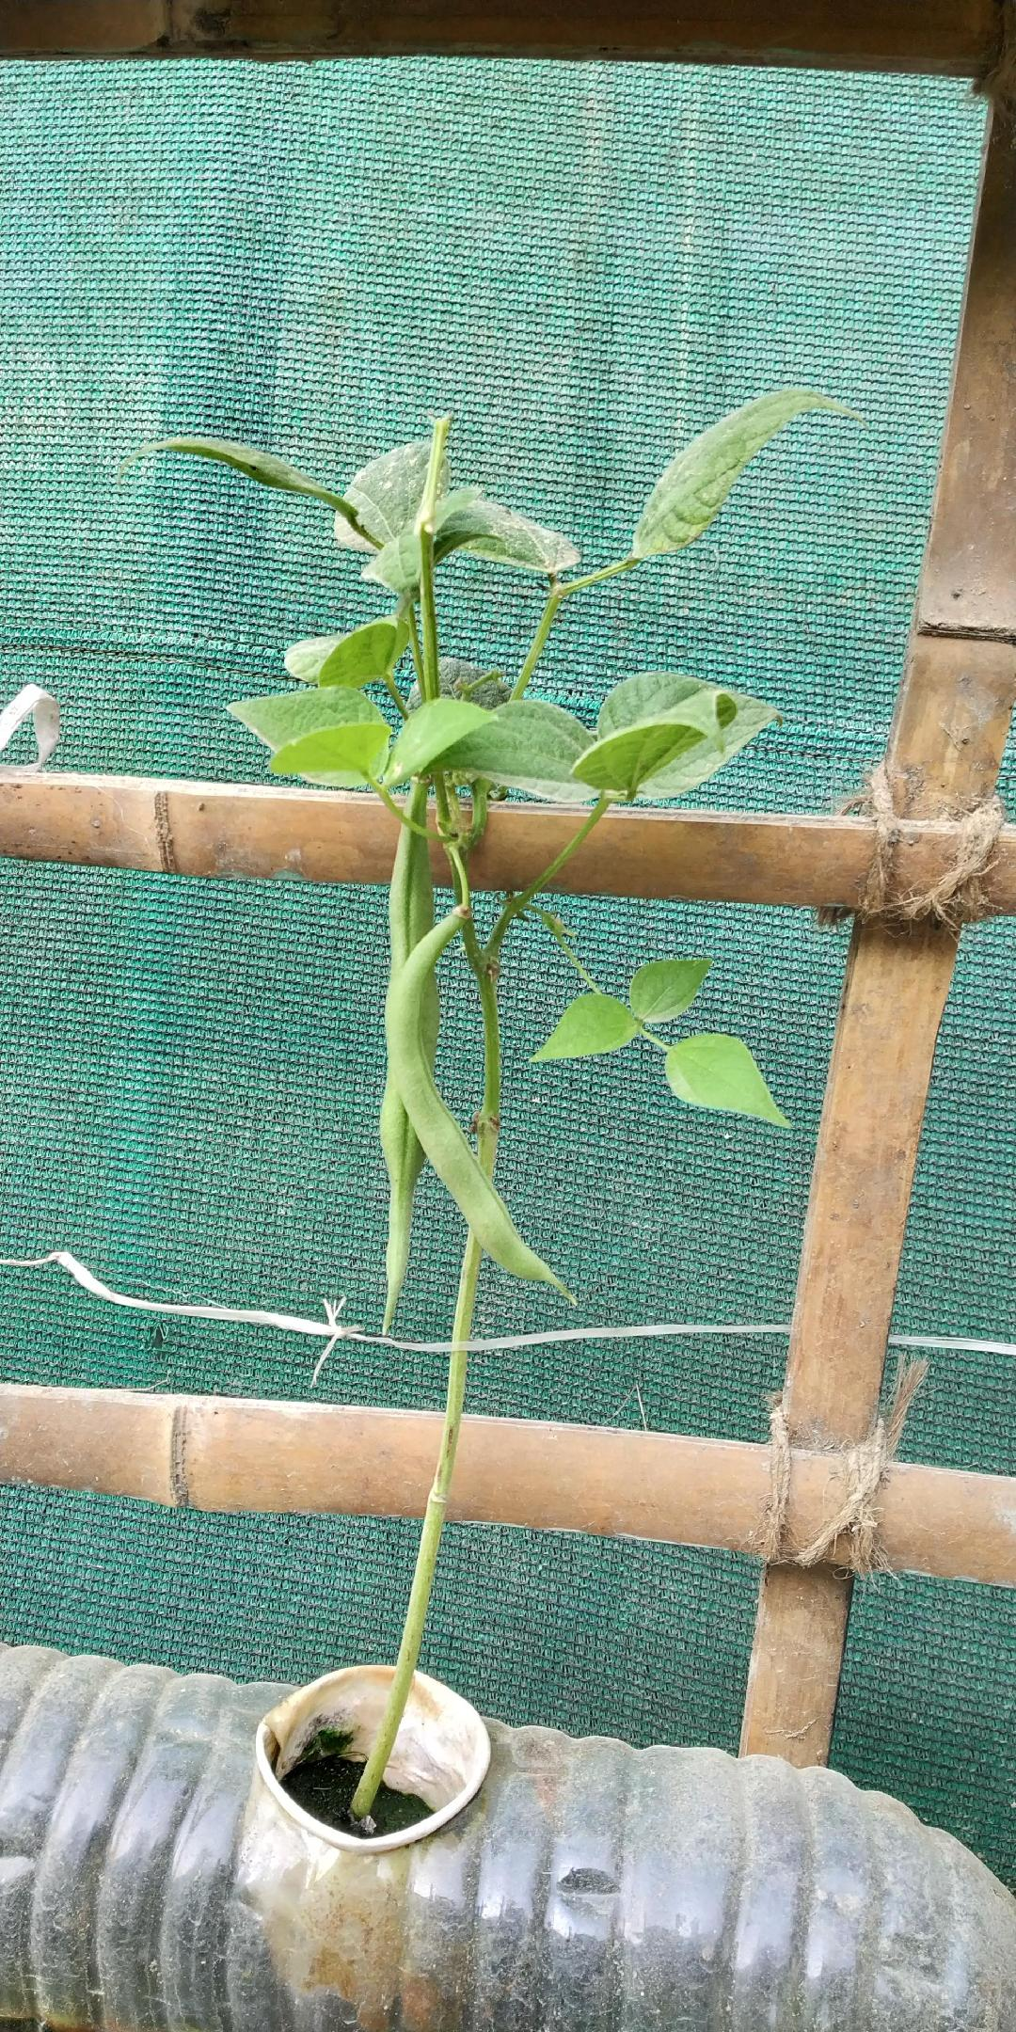
Low cost design for hydroponic cultivation using waste material

Slide 13
No Poverty – End poverty in all its forms everywhere
With hunger problem solved through free ration and nutrition ensured through vegetable cultivation, poverty eradication especially rural poverty can be alleviated by creating micro entrepreneurship in rural areas.
No doles but making them micro entrepreneur will eradicate poverty
Few technologies viz., Sukhet model, monetization of agricultural waste, and integrating Rapid Aquaculture system, cookies preparation by fishes produced and its supply to aaganwadi children. These will create huge employment opportunities which will alleviate poverty alongwith environment improvement and waste management.

Slide 14
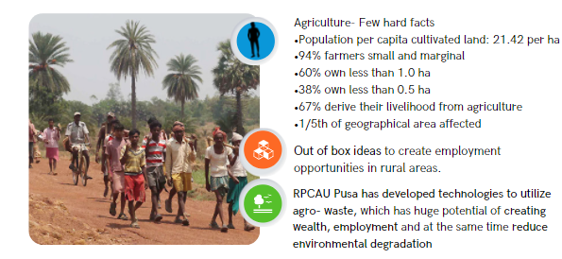
Creating Employment Opportunities in Rural Areas

Slide 15
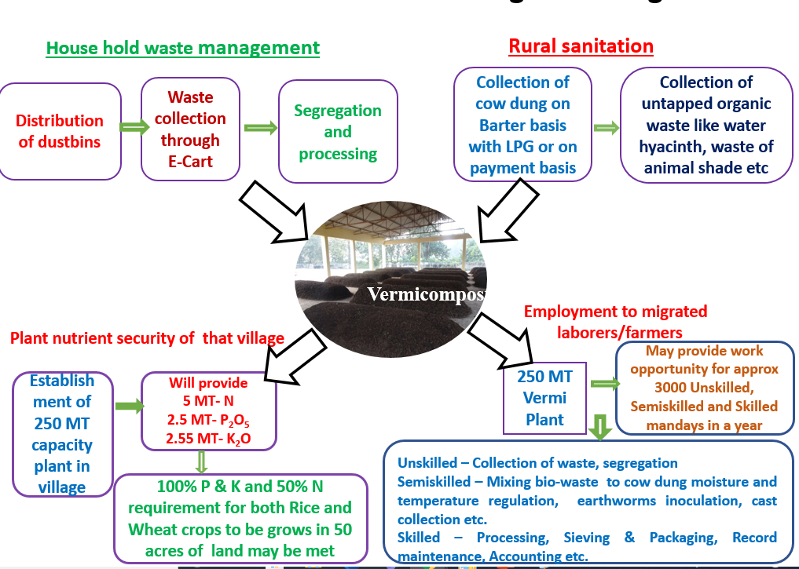
Sukhet Model – Monetizing Cow Dung

Slide 16
Sukhet Model
Hon’ble Prime Minister mentioned this model in 80th episode of Man Ki Bat on 29th August, 2021
This story was selected among 100 stories of Man ki Bat on occasion of completion 100 episodes of Man ki Bat and one colleague who was involved in this project was guest on Republic Day Parade
India Post issued a Postage stamp on this entitled “ Sukhet Model – Dhuaon Mukt Swachh Gaon”

Slide 17
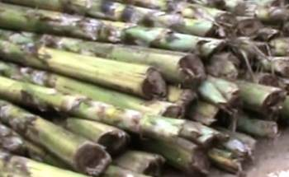
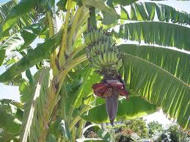
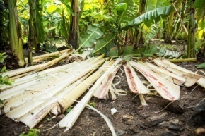
Banana Pseudo-stem

Slide 18
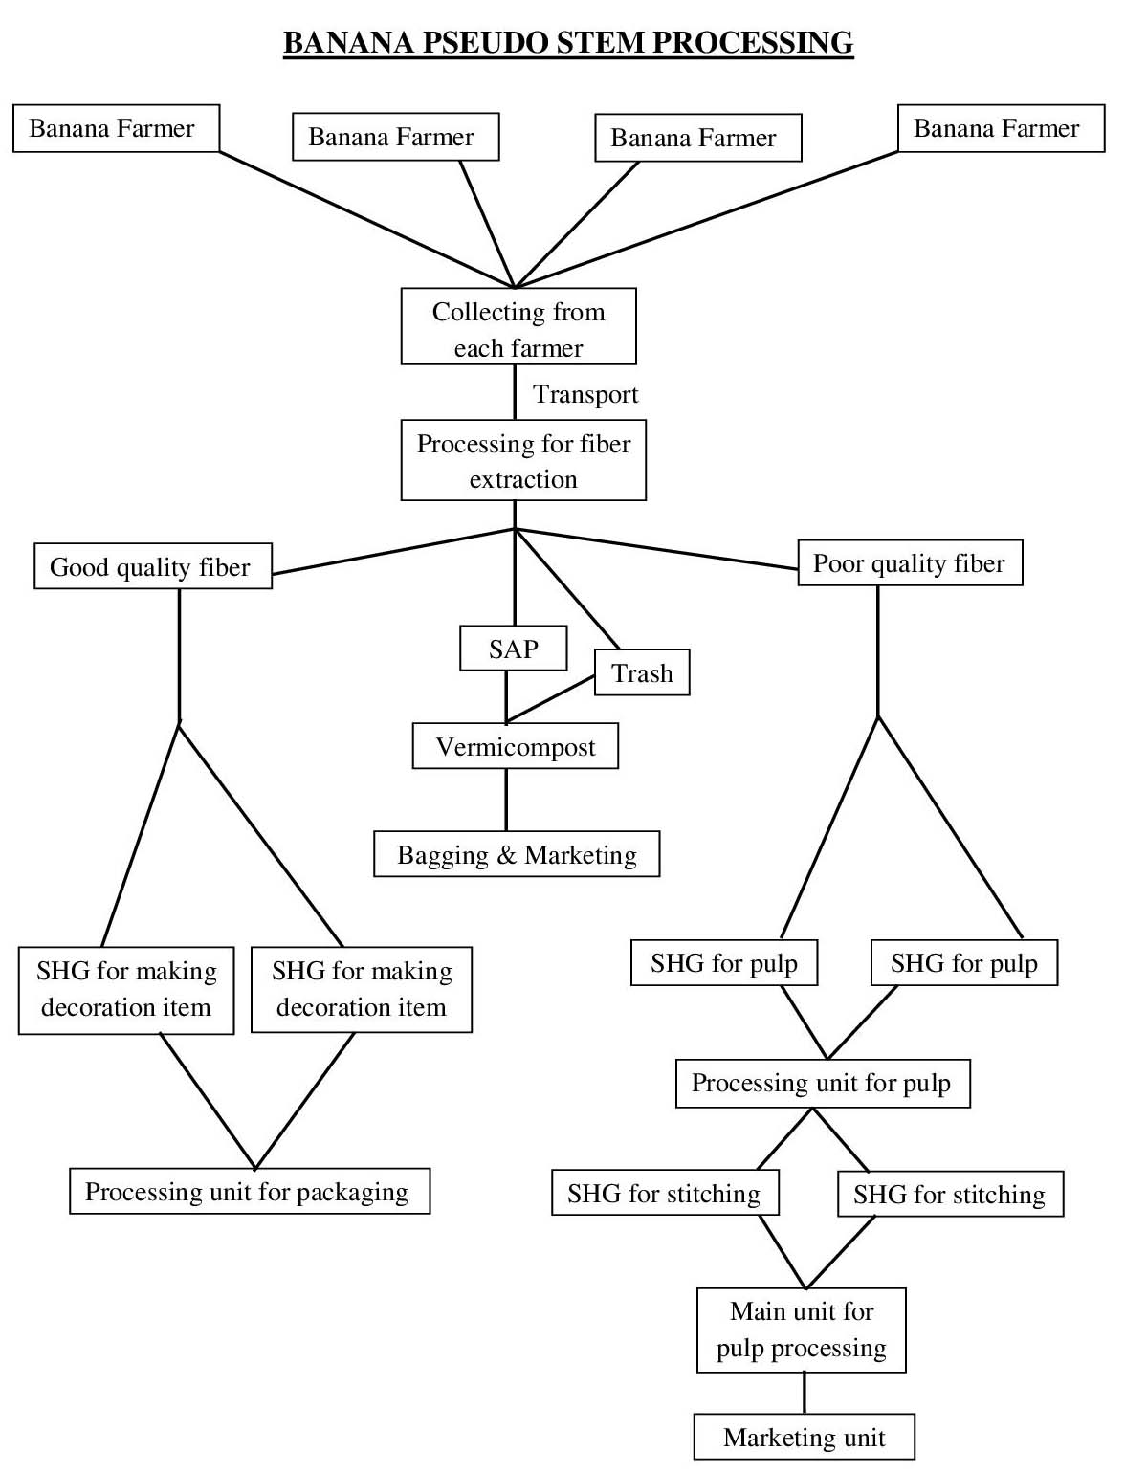
Banana Pseudo-stem processing

Slide 19
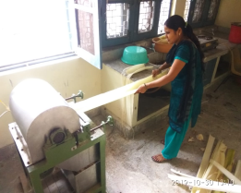
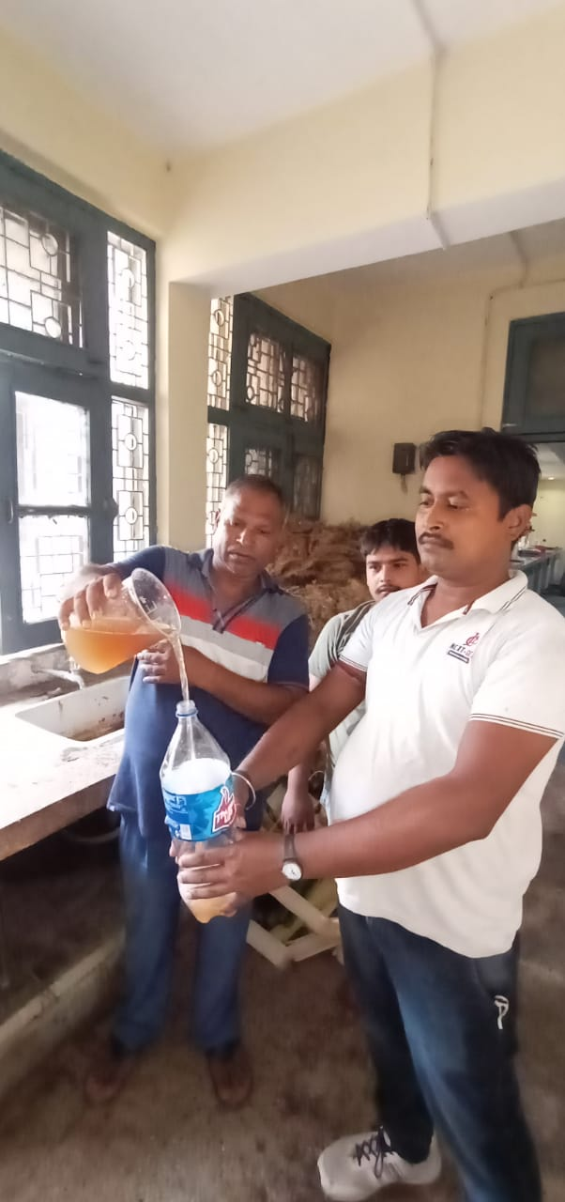
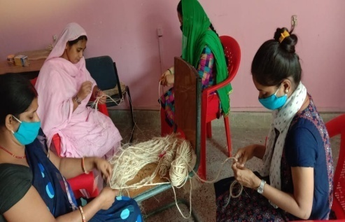
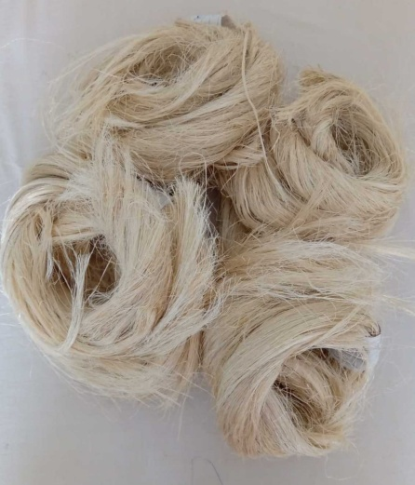
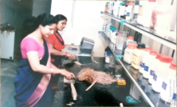
Banana Fiber Processing

Slide 20
Uses of Banana Fibre
Blending in natural fibre or other fibres. Good quality fibres are being used by silk manufacturers and other by cotton fabric producers.
To make file covers and other artefacts
Use in manufacturing of organic sanitary pads – not available off self at present in India. Very essential to tackle problem of disposal
Blending for making rugs, door mats and lower end carpets

Slide 21
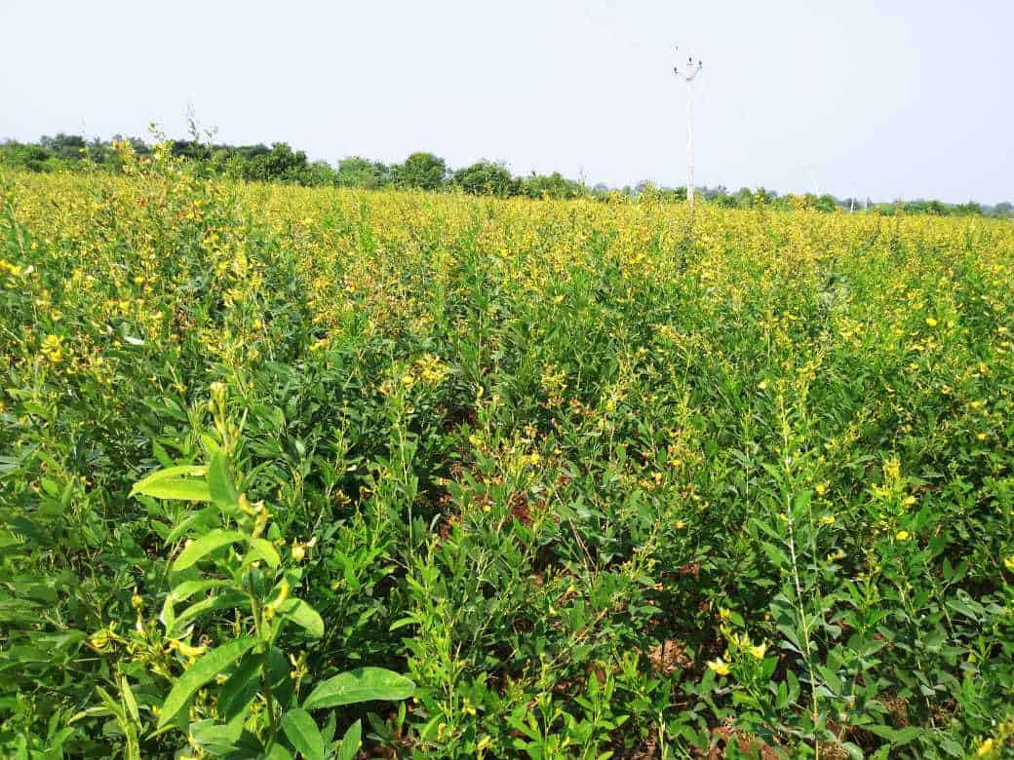
Pigeon Pea Stalk Utilization

Slide 22
Processing of waste from Pigeon pea stalks
Different size cutting sample
Pigeon pea wood
Stems of Pigeon pea
Pigeon pea bark
Pigeon pea fibre

Slide 23

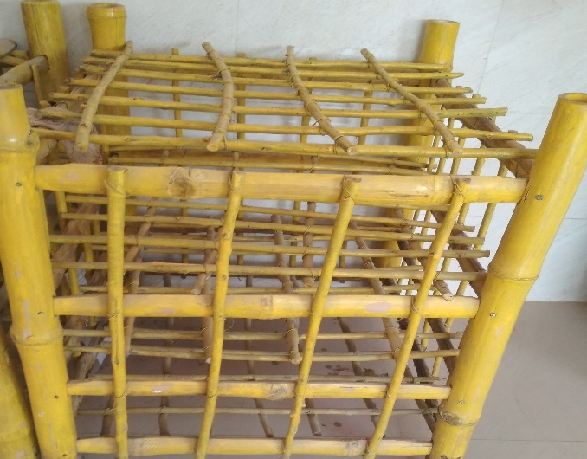
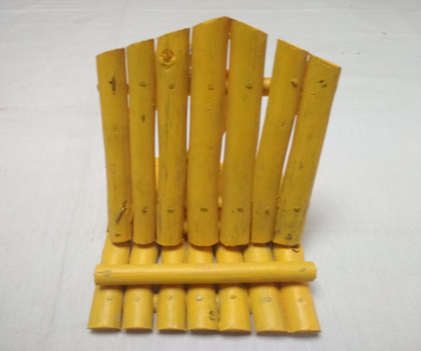
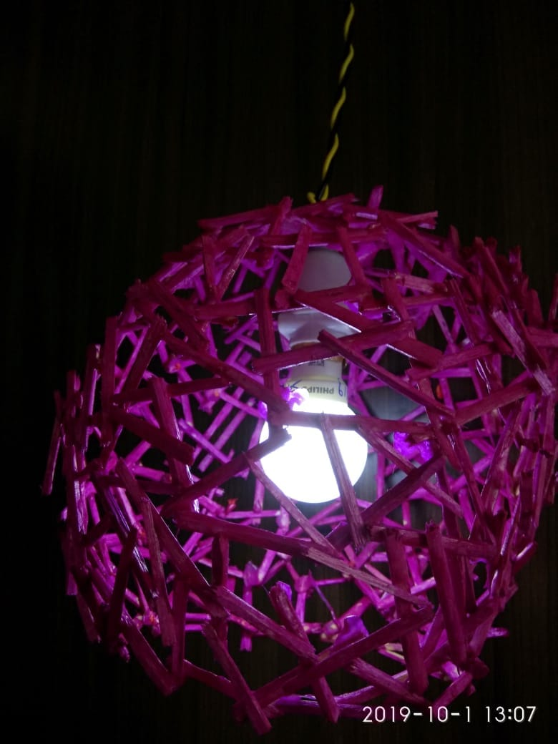
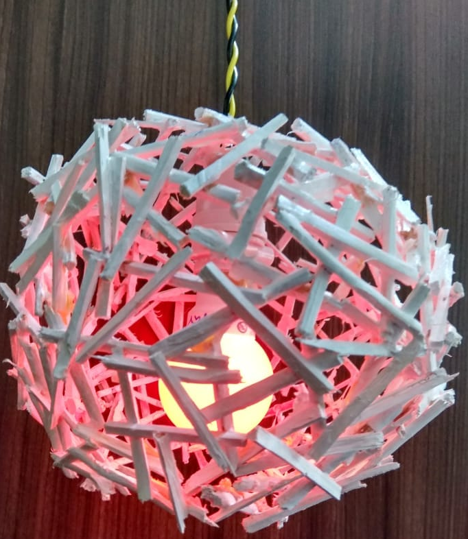
Decorative Products from waste wood of Pigeon Pea
CABBAGE STAND
MOBILE STAND
BULB HANGING

Slide 24
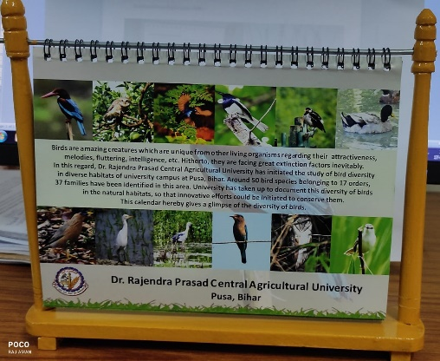
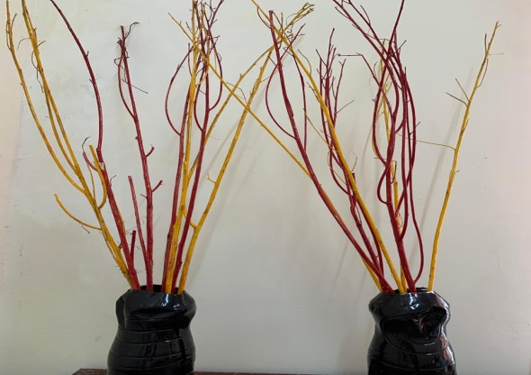

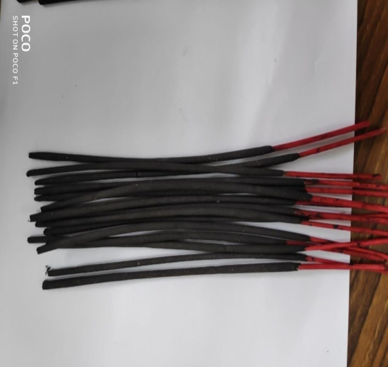
Products from stalk Pigeon Pea
Calendar Stand
Planters
Warli Arts
Incense sticks

Slide 25
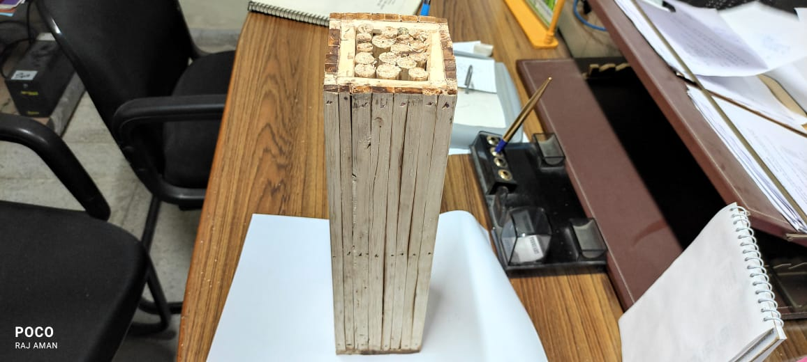
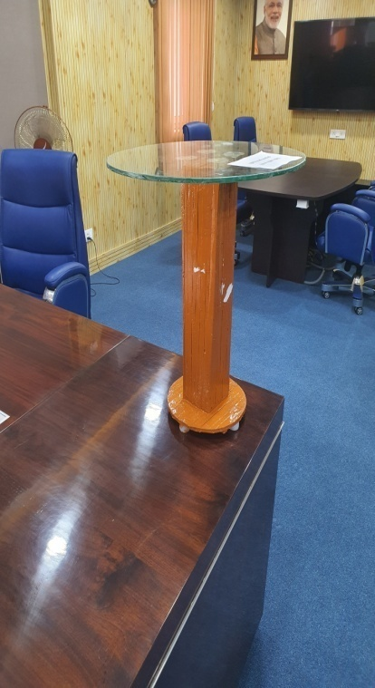
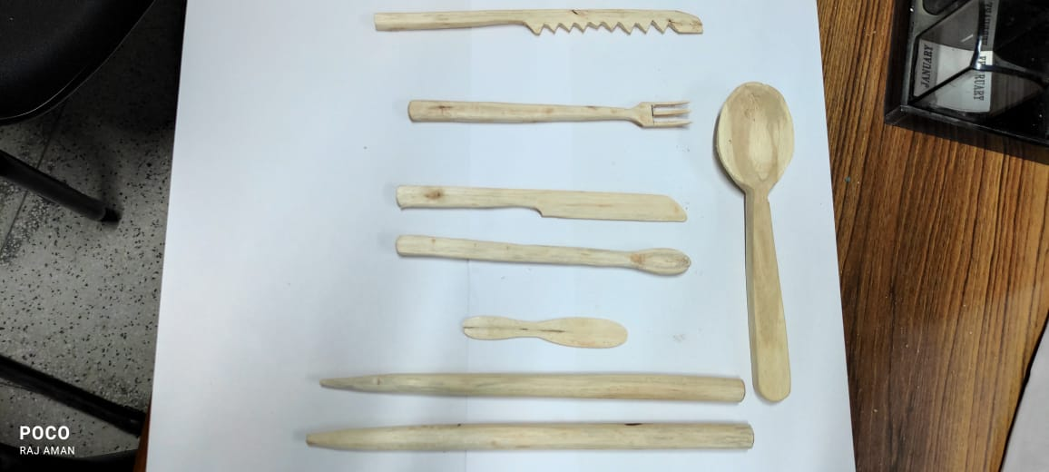
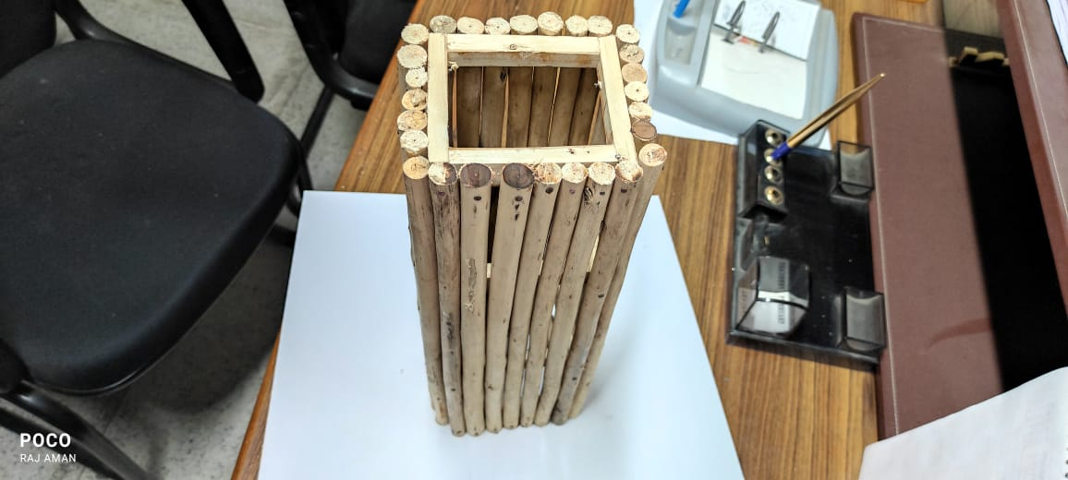
Products from stalk Pigeon Pea
Cutlery
Stand For Table
Side Table

Slide 26
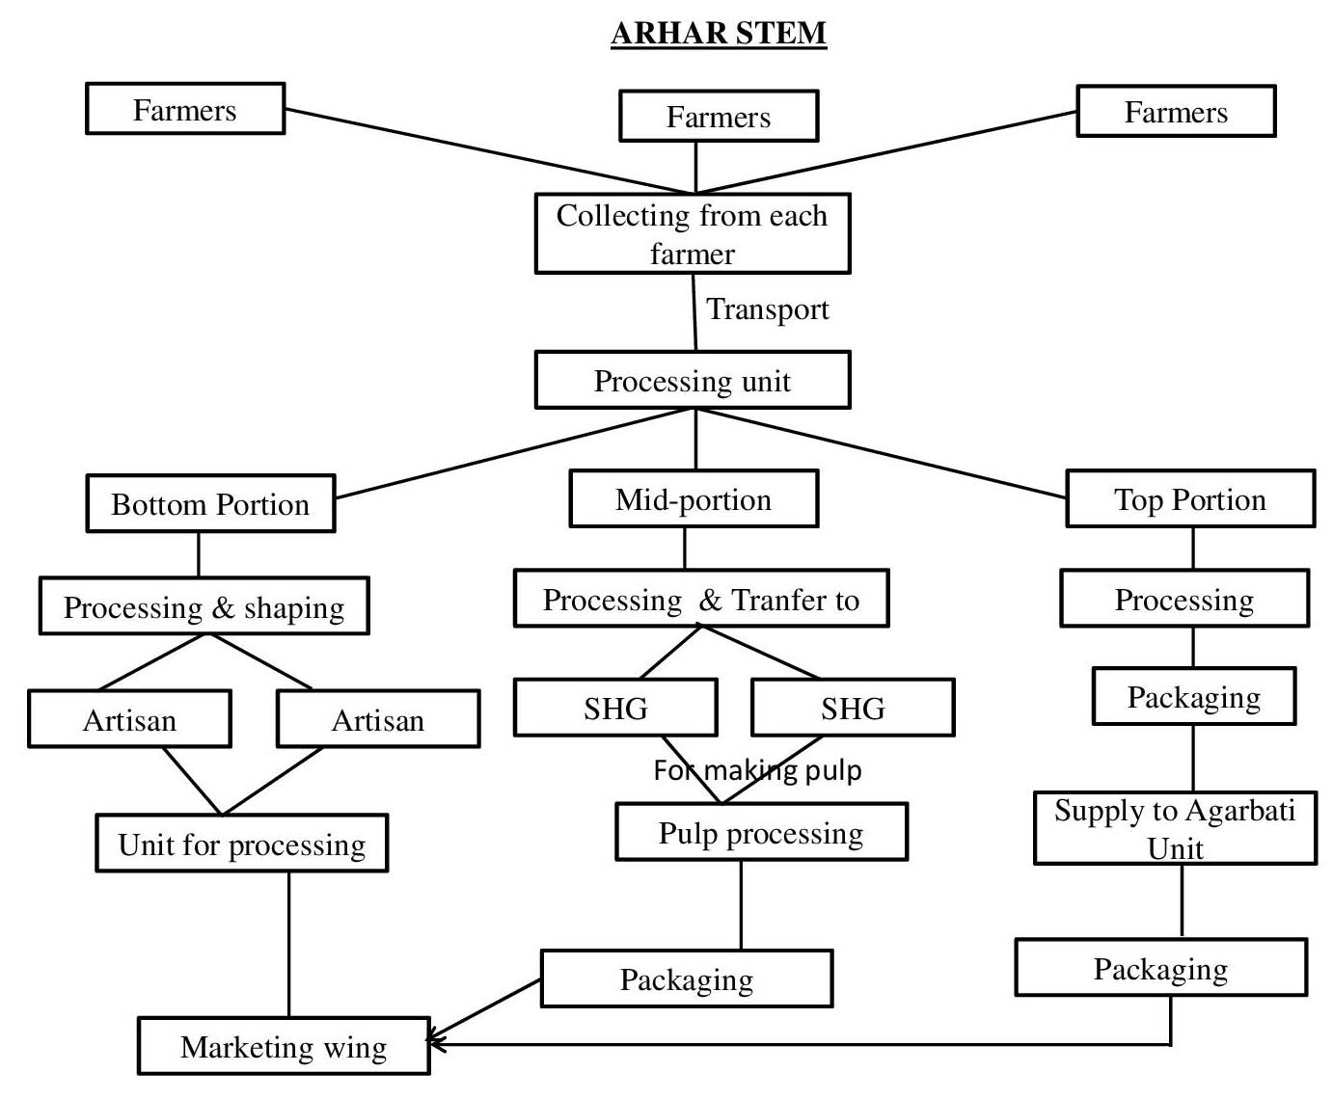
Processing of Pigeon-pea or Arhar stalk

Slide 27

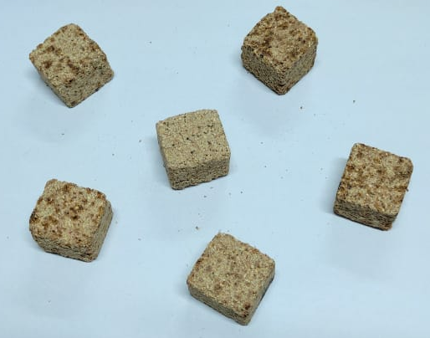
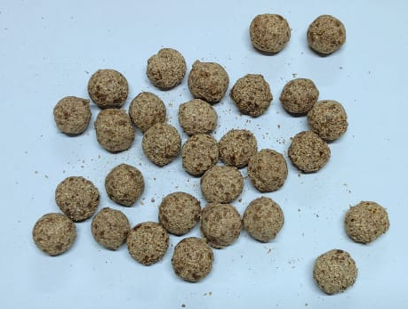
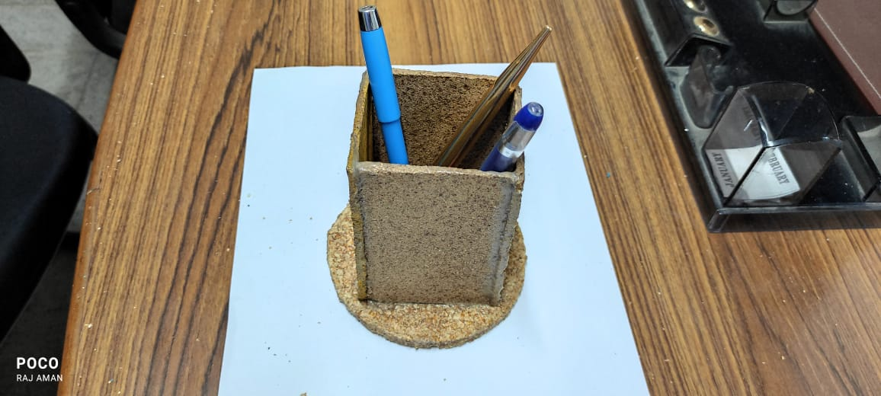

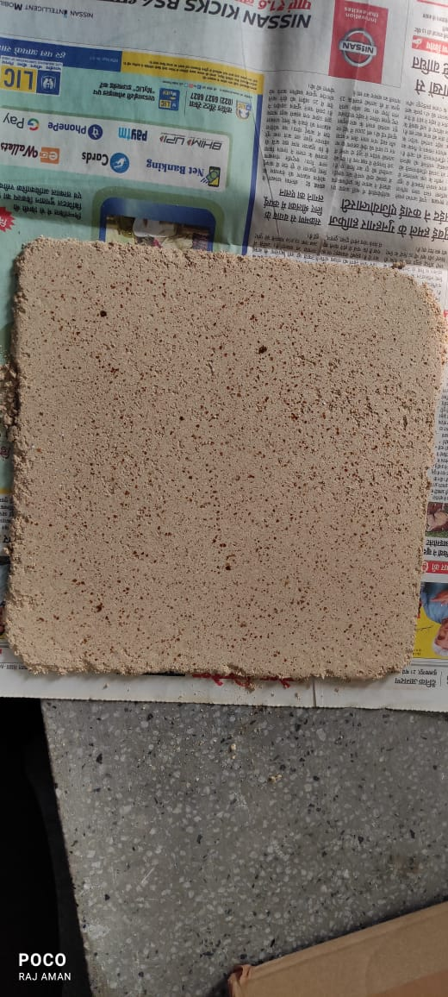
Products from Maize Cob Stone

Slide 28
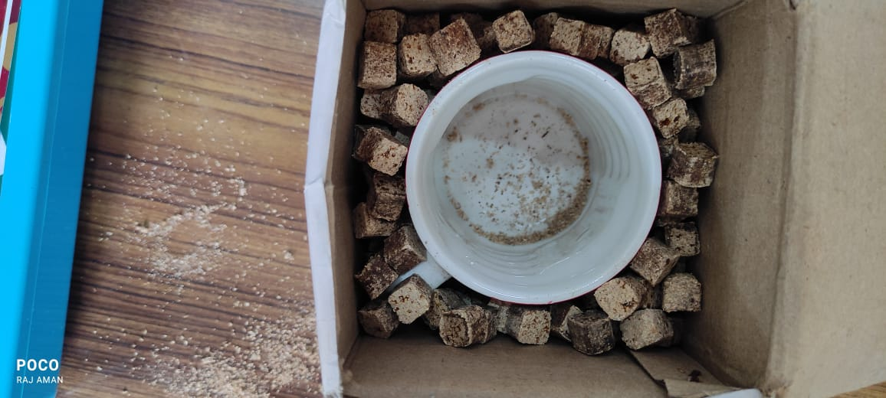
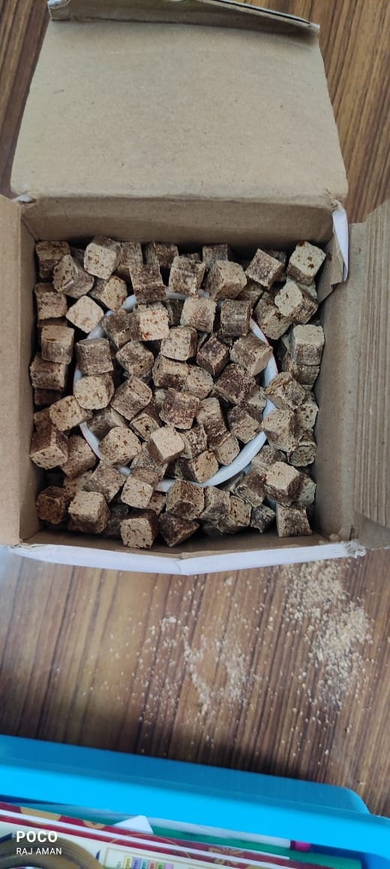
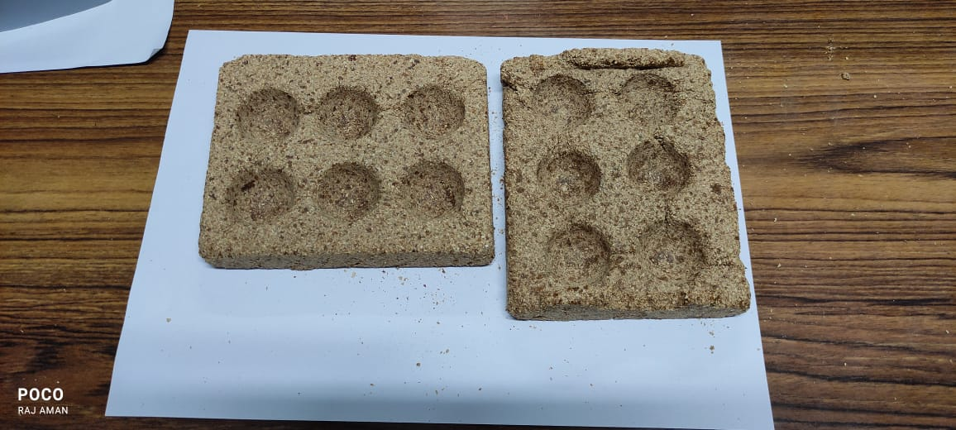
Products from Maize Cob Stone
Egg carrying
tray
Packaging Material

Slide 29
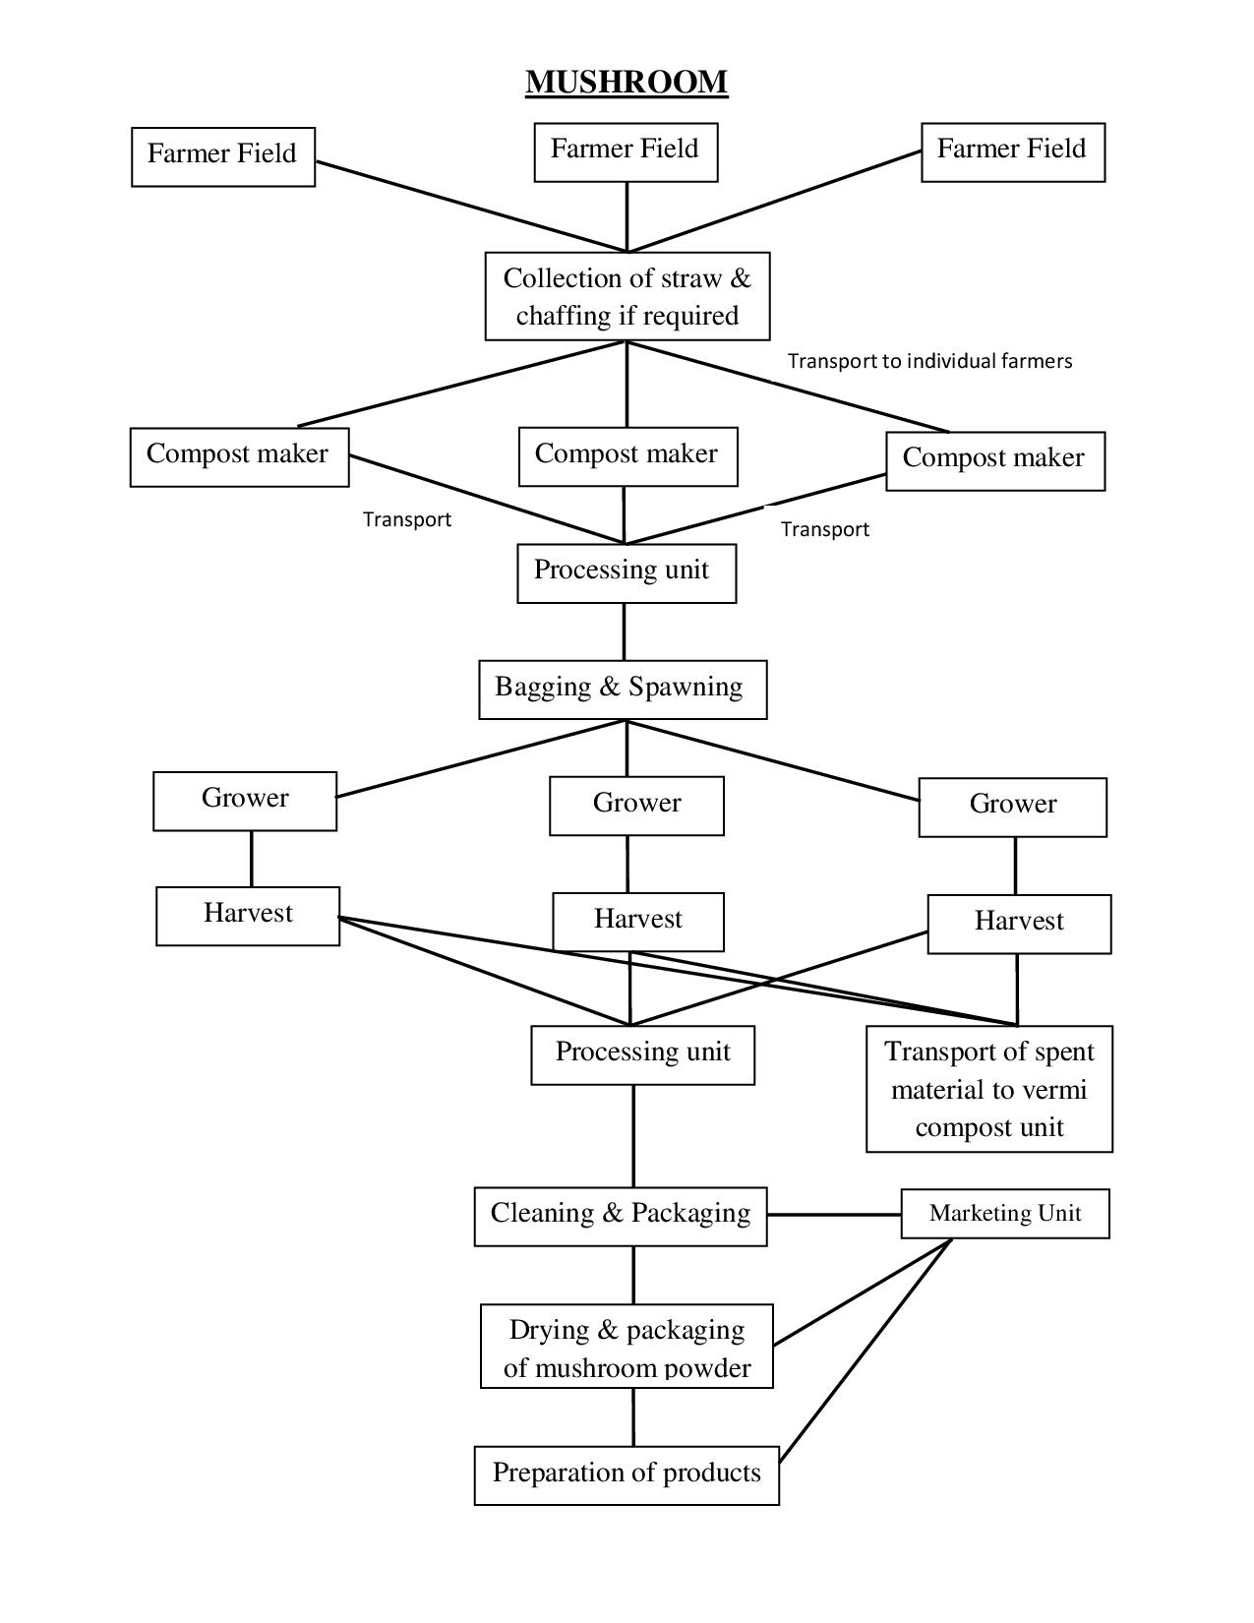
Mushroom Production from Paddy Straw

Slide 30
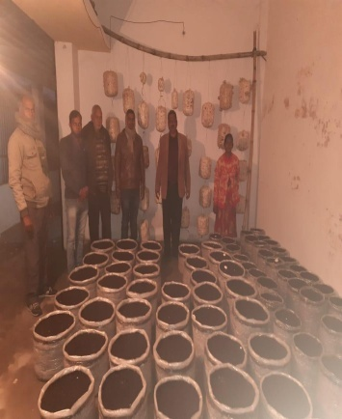
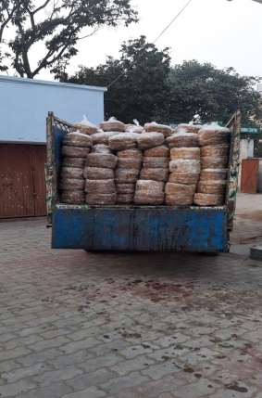
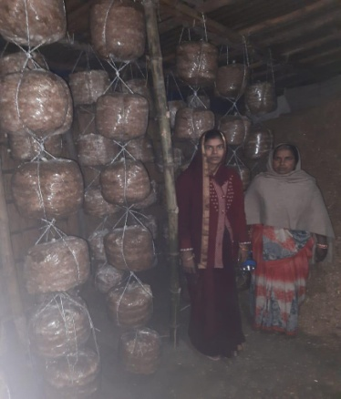
Mushroom Production System

Slide 31
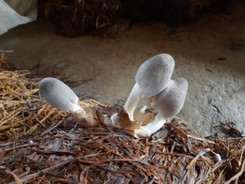
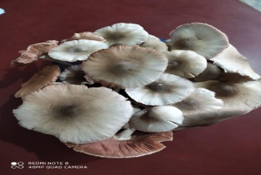
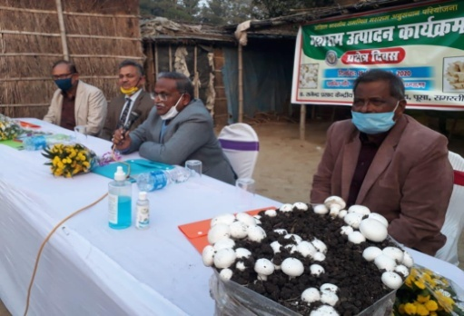
Mushroom Production System

Slide 32
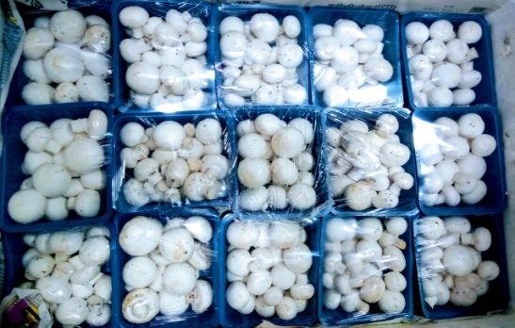
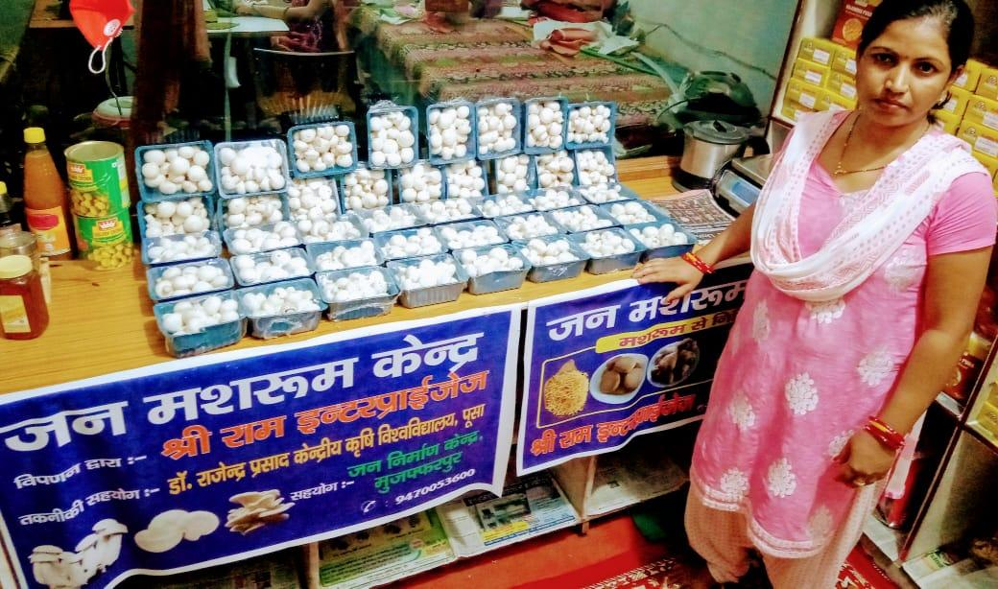
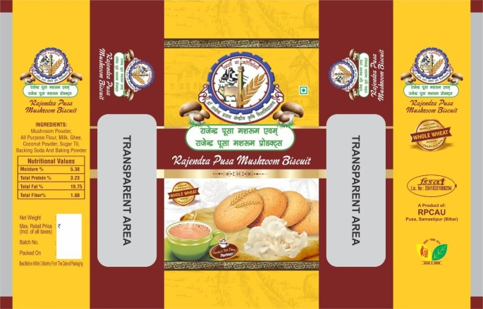
Mushroom Production System

Slide 33
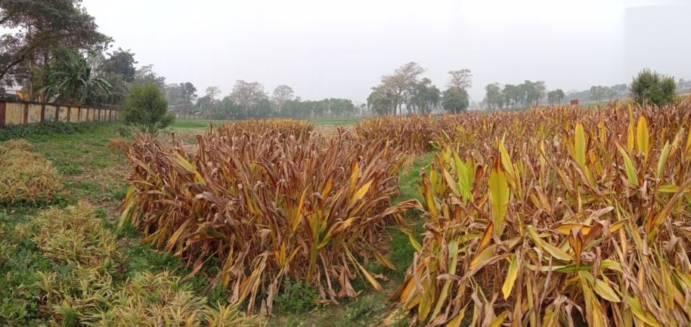
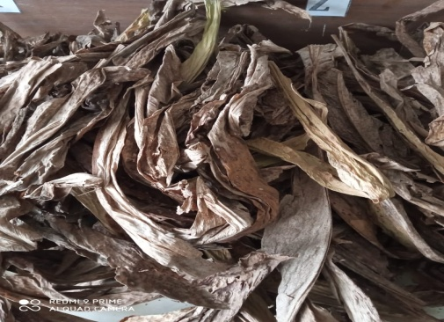
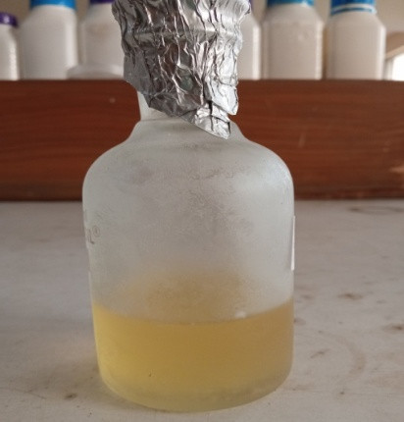

Turmeric leaf oil as a potential pest control
Turmeric cultivated in the field
Waste turmeric leaves
Isolated Essential oils
Mosquitocidal
(Mosquito repellant)
Plant pathogens control
Storage pest control
Weed pest management
Food Preservatives
Opportunities

Slide 34






Process for making Watermelon jaggery
Rind percentage: 7.5 to 12.50 % (w/w)
Binding agent (Gum ghatti):5 to 15 % (w/w)
Sweetening Agent (Stevia): 7.5 to 12.5 %w/w
Watermelon juice
Rind juice (14.33 %)
Cooling
Moulding
Binding agent (9.86%)
Heating (90-100°c)
Watermelon Jaggery
Sweetening agent (12.5%)

Slide 35
Clean Water and Sanitation
This goal requires assured supply of good quality water to domestic users. Har Ghar Nal se Jal is an ambitious project. This project mainly taps water from ground water resources. Thus we need to augment our ground water resources both in terms of quantity and quality

Slide 36
Future Scenario of Ground Water Depletion
As the country becomes warmer, people will draw more water from underground, leading to faster depletion
India will be losing groundwater much faster, finds study
Across climate change scenarios, the researchers found that their estimate of groundwater level (GWL) declines from 2041 to 2080 is 3.26 times current depletion rates on average (from 1.62-4.45 times) depending on the climate model and Representative Concentration Pathway (RCP) scenario.

Slide 37
Impact of Ground Water Depletion
Reduction in availability of water. Already overall country is in stress situation with per capita water availability to about 1300 cu m against 1750 threshold level
Sinking/subsidence of earth surface
Reduction in lean season flow of rivers
Enhanced energy consumption in pumping – increasing cost

Slide 38

Design features of groundwater recharge shaft (CSSRI, Karnal)

Slide 39


Ground Water Recharge cum Drainage Unit (RPCAU, Pusa, Bihar)
Details of Technology
Target Aquifer : 2nd Aquifer , Annual Recharge Capacity : 3-5 ha m
Solid Removal Efficiency : 80-85 %,
Recharging depth : 45-55m
Cost : 2.0 to 2.5 Lakhs
Cleaning : Unscrew pipe line and clean the filter material

Slide 40


Different Stages of Ground Water Filtration
3rd Unit- Recharge Filter
2nd Unit- Siltation Tank
1st Unit-Stilling Basin

Slide 41


Performance of Ground Water Recharge Structure
Date 07.07.19
Water Inundated during heavy Rain (Time : 7 :00 AM)
Water drained or recharged (Time : 6:00 pm)

Slide 42
Components of Ground water Balance for RPCAU, Pusa Campus (Effect of Recharge Structures and underground pipeline)
S.N. | Component | Year
 |  | 2018 | 2019 | 2020 | 2021
1. | Recharge during monsoon season (ha-m) | 89.48 | 119.06 | 146.5 | 161.1
2. | Recharge during non monsoon season (ha-m) | 18.95 | 21.43 | 47.6 | 60.3
3. | Total annual ground water recharge (ha-m) | 108.43 | 140.49 | 194.1 | 221.4
4. | Exiting ground water draft for water supply (ha-m) | 118.24 | 122.91 | 111.90 | 114.3
5. | Exiting ground water draft for irrigation supply (ha-m) | 104.83 | 105.95 | 84.65 | 81.21
6. | Ground water draft for all uses (ha-m) | 223.07 | 228.86 | 196.55 | 195.60
7. | Stage of ground water development (%) | 205.70 | 162.90 | 101.20 | 88.30
S.N. | Component | Year
 |  | 2018 | 2019 | 2020 | 2021
1. | Recharge during monsoon season (ha-m) | 89.48 | 119.06 | 146.5 | 161.1
2. | Recharge during non monsoon season (ha-m) | 18.95 | 21.43 | 47.6 | 60.3
3. | Total annual ground water recharge (ha-m) | 108.43 | 140.49 | 194.1 | 221.4
4. | Exiting ground water draft for water supply (ha-m) | 118.24 | 122.91 | 111.90 | 114.3
5. | Exiting ground water draft for irrigation supply (ha-m) | 104.83 | 105.95 | 84.65 | 81.21
6. | Ground water draft for all uses (ha-m) | 223.07 | 228.86 | 196.55 | 195.60
7. | Stage of ground water development (%) | 205.70 | 162.90 | 101.20 | 88.30

Slide 43
Sewage disposal system designed by BARC and used at Mahakumbh 2025
During the Maha Kumbh 2025 in Prayagraj, the Bhabha Atomic Research Centre (BARC) contributed to waste management efforts by deploying advanced technologies to handle the massive waste generated by millions of pilgrims. BARC, along with other premier institutions like the Indian Space Research Organisation (ISRO), assisted in managing the daily treatment of approximately 16 million litres of faecal sludge and 240 million litres of greywater. The integration of such sophisticated solutions ensured the maintenance of hygiene and environmental sustainability during the event.

Slide 44
What is BARC Technology
It is known as BARC's advanced Hybrid Granular SBR (HGSBR) technology. This technology treats waste water by reducing its BOD and COD levels making it suitable for reuse in irrigation or safe discharge in rivers. In addition, the technology biologically eliminates harmful bacteria and viruses ensuring clean and safe water

Slide 45


Floral offerings at out temple by Lakhs of devotees becomes stinking garbage by next day- Both environmental and health hazard. To alleviate this the university developed a technology to convert it into vermicompost.
We used this technology first at Baidyanath Dham (Deoghar), one of the twelve Jyotirlingas and one of the most sacred abodes of Shiva, located in the state of Jharkhand, attracts millions ofpilgrims. The large amounts of floral offerings in the Baidyanath Dham temple is now being converted into organic manure.
Buoyed by the success at Baidyanath Dham, the University engaged with another highly revered temple of Baba Garibnath Dham, in Muzaffarpur district of Bihar and the offerings are being converted in vermicompost.
This technology will provide a model for economic and eco-friendly management of temple floral offerings.
Waste Management in Deoghar & Garibsthan

Slide 46
Filtering municipal waste water in nala itself
Filtering municipal waste water in nala itself – A Concept
This system involves construction of series of gabion filters in nalas itself. The design has been made in such a way that each filter takes care of a part of flow. The remaining part is directed to flow through next filter with again a part going unfiltered. A methodology using channel hydraulics parameters has been developed to determine the width of channel covered by filtered.
The design parameters have to be percent of nala width to be covered by filter, gap between two filters. This will be dependent upon peak time discharge, nala characteristics.

Slide 47



Gabbion Filters in Nala itself to filter waste water

Slide 48


Slide 49
Combating Impact of Climate Change

Slide 50
Impact on the Urban Hydrology
Water Supply
Drainage
Ground Water Recharge

Slide 51
How Changes Affect Urban Life
Intense rainfall stresses drainage system, causes waterlogging, damages structures
Reduces ground water recharge
High temperature increases water demand and stresses water supply system
High humidity increases chances of eruption of diseases

Slide 52

New initiatives for minimising GH gases

Slide 53

Boat Based Solar Pumping System
Designed and Developed by – RPCAU, Pusa
Target Beneficiaries : Diara Land , Dhab Land and river island Farmers of North Bihar and Eastern UP.
Rational of the Innovation: In Diara and Dhab land farming is available for a few months in a year, the pumps and other equipment mounted on land, get flooded and are difficult to use.
Major Components :
Solar Panels- 1800 watt
Submersible Pump-2 hp DC Pump
Wooden Boat
Controller
Discharge : 5-6 lps
Patent Application No. : 201931029841

Slide 54



Trailer Based System
Power :2HP
Suitable for Tal & Diara Area
Mounted on normal Tractor Trolley
Irrigation Potential: 5-6 Acre
Approx Cost: 4.0 Lakh

Slide 55


SOLAR BASED MATSYA BANDHU
VARITIES
This helps fish retailers to avoid distress sale in late hours of day as well a hygienic way of storing fish on roadside and it can also be used for fish selling going around city mohalla. Government of Bihar has ordered first lot of 25 such cart which can go up to 1000 depending upon response.
Storage Capacity : 30-40 Kg.
Approx cost: 1,10,000/-

Slide 56

Solar Tree based Pumping System
Target Beneficiaries : Tal land (South Bihar) and Diara land Farmers (North Bihar and Eastern UP)
Rational of the Innovation: In Tal Area farming is available for a few months in a year and due to non availability of electricity pumping is costly affair.
Major Components :
Solar Panels- 5kw
Submersible Pump-5 hp
Controller
Discharge : 8 lps
Command Area :-8 ha

Slide 57


Solar Trees Based Pumping System for Remote areas
Capacity: 5 KWp
Can operate 5 hp submersible pumps.
Cost Rs. 5.25 lakh
Saves land in mounting solar panels
More efficient than conventional solar systems
Provides safety from intentional damage
Recommending to use sprinkler/ drip irrigation systems for efficient use of water
This system was presented to Hon’ble Governor of Bihar in Oct. 2017 and on his instructions the system has been installed in Raj Bhawan, which is functioning satisfactory.

Slide 58
SOLAR BASED MATSYA BANDHU
VARITIES
This helps fish retailers to avoid distress sale in late hours of day as well a hygienic way of storing fish on roadside and it can also be used for fish selling going around city mohalla. Government of Bihar has ordered first lot of 25 such cart which can go up to 1000 depending upon response.
Storage Capacity : 30-40 Kg.
Approx cost: 1,10,000/-

Slide 59



Compendium of Solar Powered Irrigation System in India (Published by IWMI)

Slide 60
Life on Land – Protect, restore, and promote sustainable use of terrestrial ecosystems, forests, and biodiversity
Accelerated Reclamation of Degraded Lands
Wetland Management

Slide 61
How serious is wasteland issue
Wastelands are degraded lands that have lost their ecological productivity due to factors such as deforestation, desertification, industrial pollution, and poor land management.
These lands are often barren, unproductive, and prone to environmental degradation, making them unsuitable for agriculture, habitation, or natural ecosystems.
Land degradation such as this occurs when land cover is lost or removed, causing vulnerable soil and organic matter to be washed or blown away.
The symptoms are many and alarming: expansion and movement of sand dunes, diminished rainfall, depletion of pastureland, erosion from wind and rain, and loss of biomass and biological integrity. The resulting human suffering is severe. For farmers, this means greater food insecurity and financial hardship.

Slide 62
How serious is wasteland issue
About close to 30 per cent of its geographical area of country is already affected, and thus, land degradation is definitely among India’s most pressing environmental problems.
To make matters worse, almost all Indian states have recorded an increase in degraded land in the past 15 years, with the most rapid increase being noted in the biodiversity-rich northeastern states.
Currently, 97.85 million hectares (Mha) of land — an area 2.5 times the size of India’s largest state Rajasthan— has already been degraded. Of this, 3.32 mha — an area 22 times the size of Delhi — has been added in the 15 years between 2003-05 and 2018-19.

Slide 63

Ravines of Semi Arid region of India

Slide 64

Degraded areas of Western Ghats

Slide 65
Initiatives for Wasteland Reclamation
Government has launched several schemes/ programmes which include inter-alia National Afforestation Program, Green India Mission, Watershed Development Component of Pradhan Mantri Krishi Sinchayee Yojana (PMKSY) which contribute to the target of restoration of 26 million hectares of degraded land and achievement of land degradation neutrality with focus on sustainable and optimum utilization of land resources.
It is working to restore 26 million hectares of degraded land by 2030. Delivering the keynote address at a United Nations high-level dialogue on Desertification, Land Degradation and Drought., Prime Minister Narendra Modi said that India is on track to achieve its national commitment on land degradation neutrality, and this would contribute to India’s commitment to achieving an additional carbon sink of 2.5 to 3 billion tonnes of carbon dioxide equivalent.

Slide 66
Why Accelerated Reclamation
Given the constraints, present pace of reclamation will not be sufficient to achieve the target in view of new areas being added due to factors mentioned above. Thus a different approach is envisaged which has been named Accelerated Reclamation.
Accelerated reclamation of wastelands refers to the rapid restoration and rehabilitation of such lands to enhance their ecological value and usability. The primary goals of accelerated reclamation are to restore soil health, promote vegetation growth, improve water retention, and convert the land into a productive resource in a much shorter time with least mortality.
Accelerated reclamation of wastelands is crucial in the face of global challenges such as food insecurity, climate change, and land degradation. By restoring wastelands efficiently, countries can unlock new economic potentials, protect ecosystems, and promote environmental sustainability.

Slide 67
Accelerated Reclamation of Wastelands Using Wastewater
A Practical Approach
Experience of wasteland reclamation with these methods have not been very encouraging. Thus we need a system where the survival rate is high, growth is fast and economic returns justify the investment. Irrigating plantation coupled with fertilization and selection of fast growing species having economic value as well as potential of generating jobs locally for processing etc has been found very effective. However, with increasing pressure on quality fresh water, its availability for irrigating such plantation may not be feasible. Thus using wastewater for irrigating such plantation has immense potential.
Utilizing wastewater for the reclamation of wastelands is an innovative and sustainable approach, especially in quality fresh water-scarce regions. Wastewater, even if not treated fully, can be a valuable resource for irrigation, soil improvement, and biomass production for all those trees/shrubs which don’t be part of food chain.
This only addresses the issue of land degradation but also contributes to effective wastewater management. In addition, it can be good source of earning carbon credit.

Slide 68
Sandcasted area on banks of river Burhi Gandak
Bamboo plantation 20 days after
receding flood water
Depth of deposition: 55 cm
Depth of deposition: 80 cm

Slide 69
Details of System: Boat based solar pumping system, Drip system, installing underground drip, drip discharge 1.35 lph at operating pressure (0.5-0.8 kg/cm2)

Slide 70
Plantation area submerged with flood water from 17th July to 6th August, 2019
Water stagnation: 0.70 – 1.30 m for 20 days

Slide 71
One Year Old Bamboo

Slide 72

Irrigated Bamboo Plantation on sandcasted area on banks of Burhi Gandak (5 year old)

Slide 73

Another view of Bamboo plantation

Slide 74

Wetlands
Wetlands usually occupy a transitional zone between well-drained uplands and permanently flooded deepwater habitats; include swamps, salt marshes and bogs.
Many wetlands are permanently or intermittently flooded with shallow water; others are characterized by water tables that are at or near the surface.
Notes:
74

Slide 75

Wetlands develop in areas where the water table is at or near the surface
Water table - the upper surface of groundwater below which soil is saturated with water that fills all voids
Notes:
Groundwater lies beneath the soil surface in geological deposits called aquifers (areas of permeable rock, clay and sand) as illustrated in this image. The water table is defined as the upper surface of groundwater below which soil is saturated with water that fills all voids. Wetlands develop in areas where the water table is at or near the surface. Therefore, wetlands that appear to be separated from one another may actually be linked through underground aquifers. Although not necessary for the development of a wetland, such areas may be periodically covered with shallow water.

Slide 76

Wetland Functions and Values
Functions - ecological services provided by wetlands
Values - estimates of the importance or worth of one or more of a wetland’s functions to society
“When both the marketed and non-marketed economic benefits of wetlands are included, the total economic value of unconverted wetlands is often greater than that of converted wetlands.”
Notes:
For most of the 20th century, wetlands were viewed as “wastelands” or as areas that provided little benefit beyond waterfowl habitat. This growing concern prompted governments at all levels to enact legislation that would protect remaining wetlands and attempt to restore some lost wetlands.
Functions are ecological services provided by wetlands and may be categorized in a number of different ways (see below for one way).
Values are estimates of the importance or worth of one or more of a wetland’s functions to society.
Humans may assign value to wetlands as a result of their location in the landscape, the wide variety of functions they perform or the uniqueness of their plant and animal communities. Individuals may also value wetlands for their aesthetic qualities, as sites for education and scientific research, as locations of historical or archaeological significance or as repositories for water during floods.
Estimates of “value” can be determined in a number of different ways. For example:
the revenue generated by the sale of fish and shellfish that depend on wetlands for part of their life cycle
the tourist dollars that are associated with a wetland
measures of public support for protecting fish and wildlife
Assigning values to aesthetic and ecological services is inherently difficult due to individual differences in value systems.

Slide 77

Wetland Functions
Hydrological processes
Water quality improvement
Fish and wildlife habitat
Carbon sink.
Notes:
77

Slide 78

The Value of Wetlands
Wetlands are among the most important and productive ecosystems on earth.
The high net productivity of wetlands is the result of rapid recycling of nutrients that occurs with changing water levels and the breakdown of organic material catalyzed by wet conditions.
Dead plant material, rapidly broken down in water by microorganisms, which in turn is fed upon by aquatic invertebrates, is the basis for food webs that support the abundance and diversity of wetland-associated wildlife.
Other functions, such as trapping sediment and pollutants, retaining rainwater, making rivers less prone to flooding, etc.
High net productivity
Abundant and diverse wildlife
Water quality improvement
Flood and storm protection
Notes:
78

Slide 79

Threats to Wetland Ecosystem
Improper development and management of wetland for fishery production in the state which is evident from poor physical status viz. greater colonization of macrophyte, siltation and habitat degradation.
Soil erosion and siltation due to faulty agricultural practices in wetland catchment.
Encroachment of wetlands for agriculture and construction activities.
Disposal of industrial and household waste without any treatment chocked the drainage line.
Slow pace of utilization due to multiple ownership and lack of co-operative/collective management approach.

Slide 80
Threats to Wetland Ecosystem
Non availability of adequate quantity of desired fish seeds and rearing facilities (pens, cages, nursery ponds).
Inadequate technology transfer and adoption by the farmers/fishers due to dearth of ecosystem and lack of community based resource specific technological packages.
Poor institutional financial support to the farmers/fishers and inadequate insurance coverage to fish crop.
Weak inter departmental linkage and co-ordination is also the major missing links in the development of wetlands.

Slide 81


Policy for Rejuvenation and Conservation of Wetlands in Bihar
Major threats to Wetland Ecosystem
Improper development and management of wetland for fishery production in the state which is evident from poor physical status viz. greater colonization of macrophyte, siltation and habitat degradation.
Soil erosion and siltation due to faulty agricultural practices in wetland catchment.
Encroachment of wetlands for agriculture and construction activities.
Disposal of industrial and household waste without any treatment chocked the drainage line.
Slow pace of utilization due to multiple ownership and lack of co-operative/collective management approach.
Weak inter departmental linkage and co-ordination is also the major missing links in the development of wetlands.

Slide 82


Slide 83
Wish You all
A very Happy Holi
and
Eid Mubarak

